Slide 1
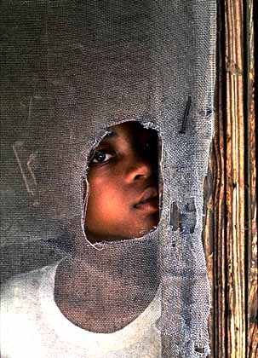

Plight of a People

Slide 2
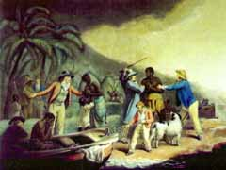
“The Slave Trade”
Painted in 1791 by George Morland

Slide 3
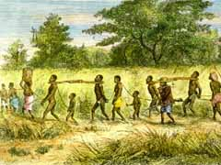
A long march lasting several months was not uncommon for slaved headed to the New World.
Captives being Driven by Black Slave Traders

Slide 4
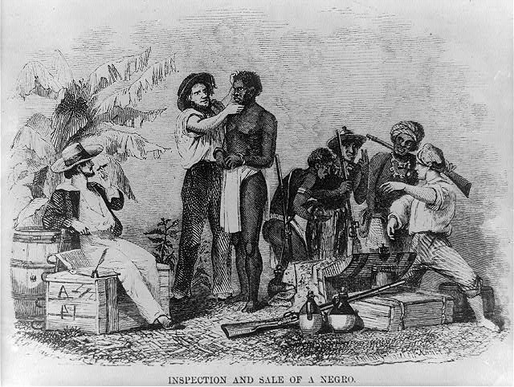
Slave Being Inspected

Slide 5
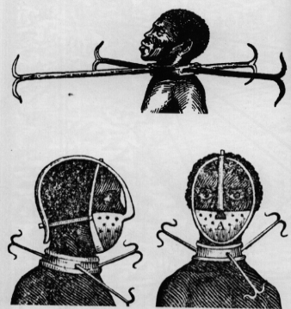
Devices used in Capture

Slide 6
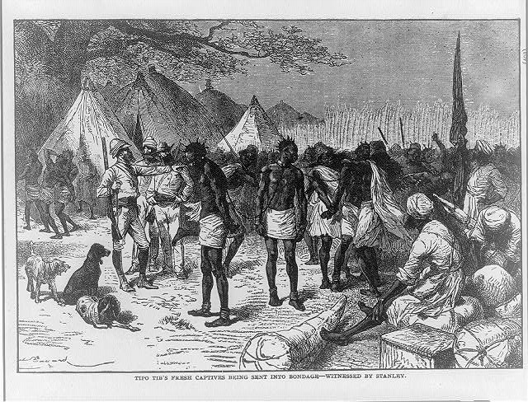
Fresh Captives in Africa

Slide 7
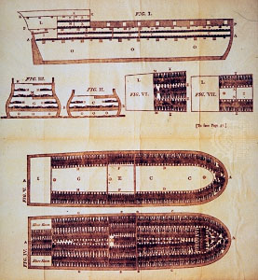
Plans of a ship for transporting slaves, 1790

Slide 8
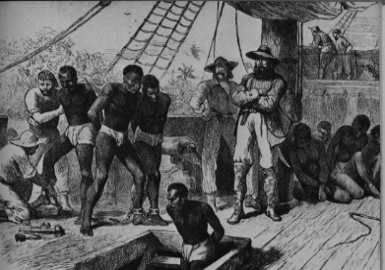
Placing into the Hold

Slide 9
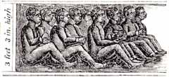
Interior of a Slave Ship reveals how hundreds of slaves could be held.
Tightly packed and confined in an area
with just barely enough room to sit up,
slaves were known to die from a lack of breathable air.

Slide 10
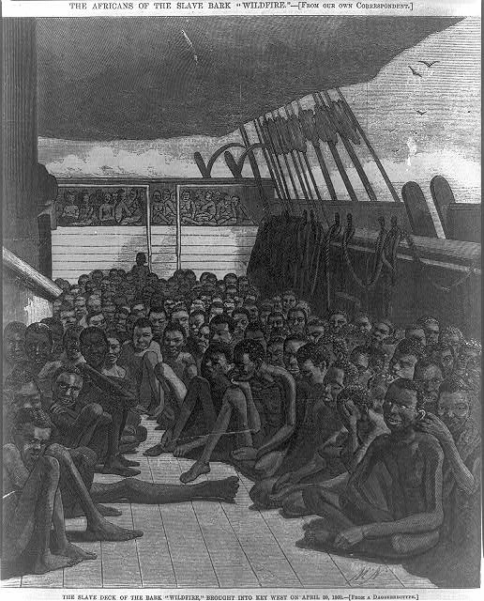
Published in the June 2, 1860 issue of Harper's Weekly,
The Slave Deck of the Bark "Wildfire" illustrated how Africans traveled on the upper deck of the ship.

Slide 11
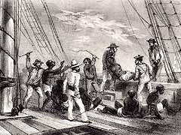
Throwing Diseased People Overboard

Slide 12
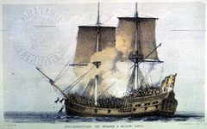
Dejected, depressed, and despondent, captives aboard slave ships felt they had nothing to lose and so took any opportunity to revolt. Here the crew fires upon the uprising slaves.

Slide 13
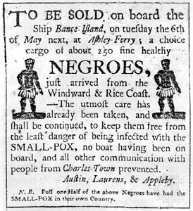
A
Broadside for
Sale of
Slaves

Slide 14
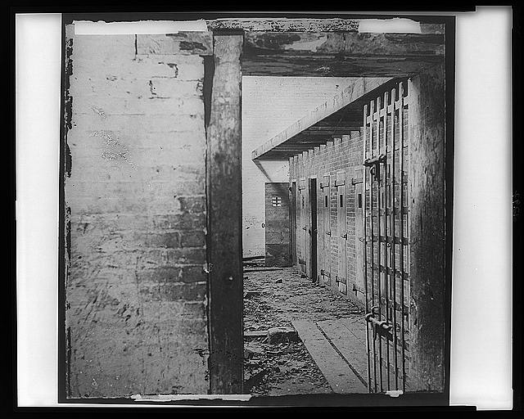
Slave Pens in Alexandria, VA

Slide 15
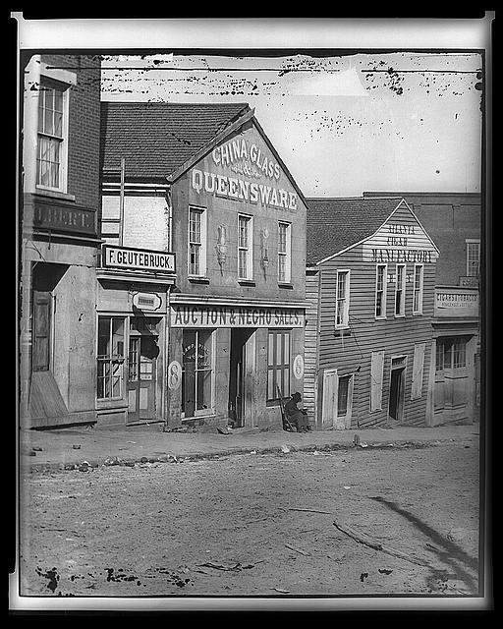
Slave
Auction
House

Slide 16
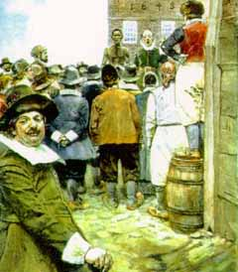
Slave Auction
American illustrator Howard Pyle, illustrator of many historical and adventure stories for periodicals, created this depiction of a 1655 slave auction in New Amsterdam (later to be named New York.)

Slide 17
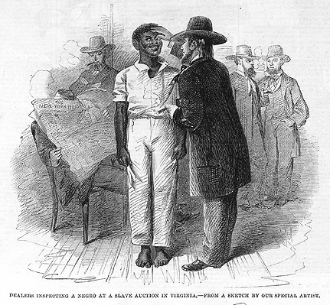
Dealers Inspecting an African American at a Slave Auction in Virginia
Harper's Weekly; February 16, 1861

Slide 18
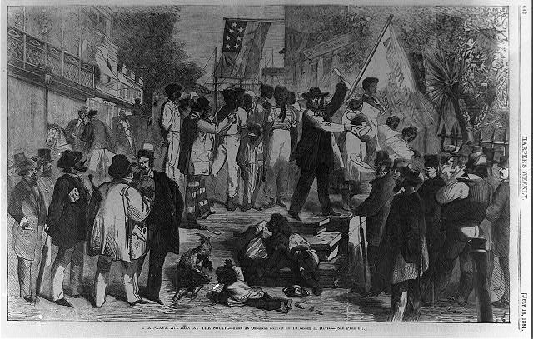
Slave Auction in Virginia

Slide 19
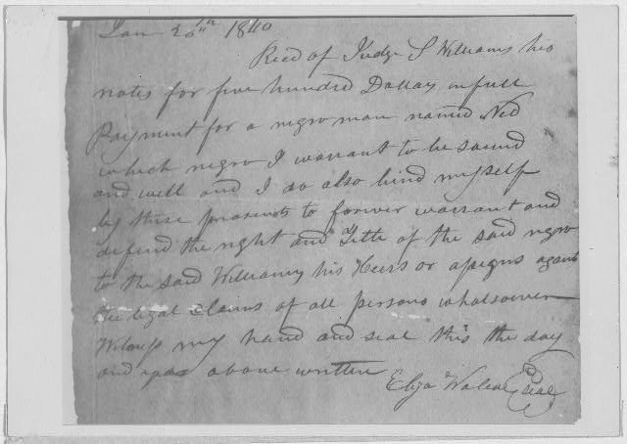
Receipt given Judge S. Williams of Eufaula by Eliza Wallace in payment of $500.00 for a man, Jan. 20, 1840.

Slide 20
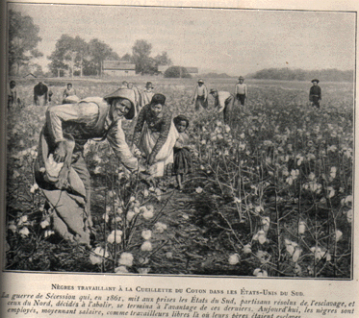
Picking Cotton

Slide 21
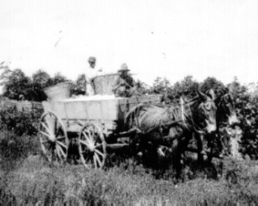

Slide 22
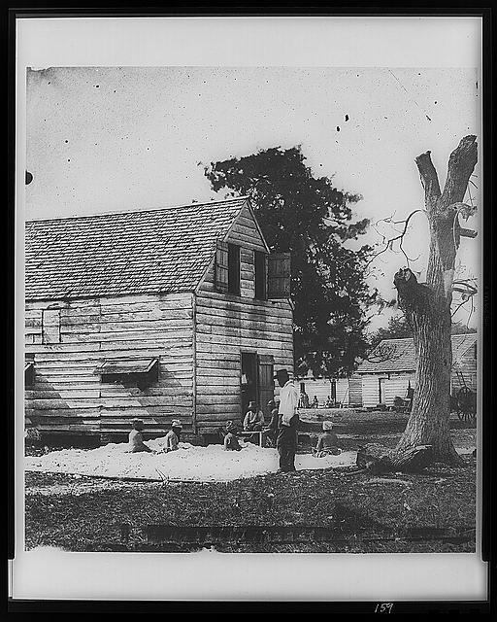
Slaves preparing cotton for the cotton gin on a plantation near Beaufort, S.C., 1862

Slide 23
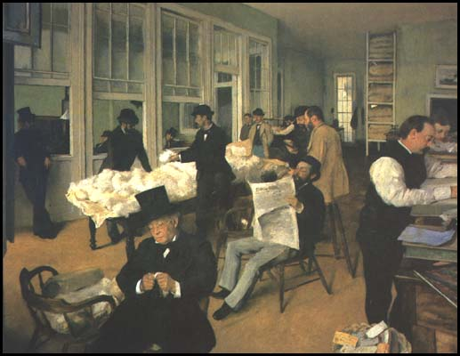
E. Degas, New Orleans Cotton Exchange

Slide 24
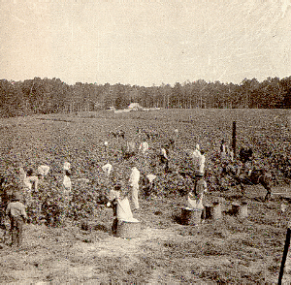
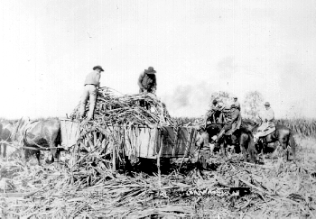

Slide 25
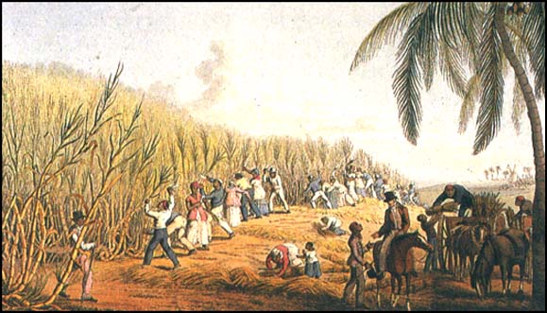
A Sugar Plantation in 1823

Slide 26
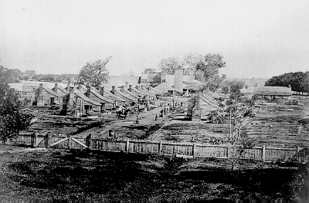
Slave Quarters, c. 1860
This slave quarter complex was located on a plantation near Bunkie, Louisiana. In the background is a large sugar house.

Slide 27
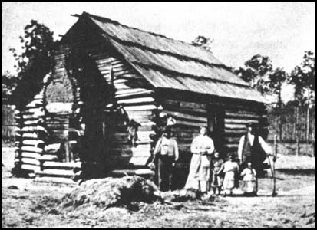
A Slave Family Outside Their Cabin
In the words of a slave: “We lodged in log huts, and on the bare ground. Wooden floors were an unknown luxury. “

Slide 28
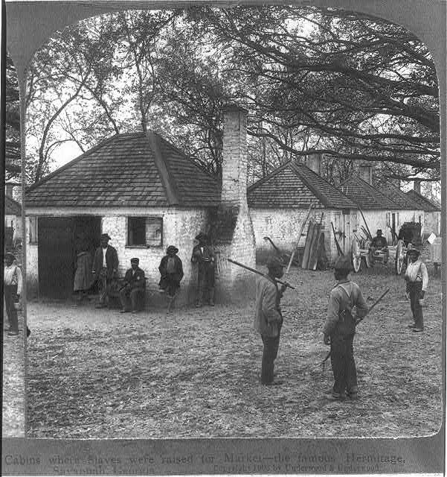

Slide 29
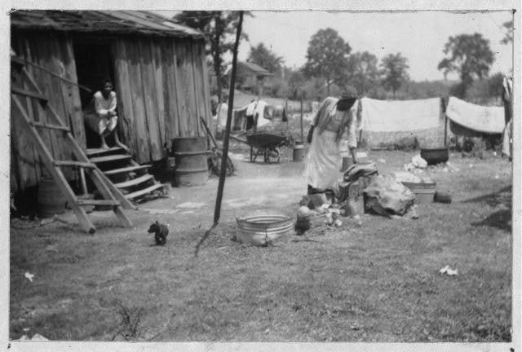
Abraham Jones' Back Yard
“We had neither bedsteads, nor furniture of any description. Our beds were collections of straw and old rags, thrown down in the corners and boxed in with boards; a single blanket the only covering.”

Slide 30
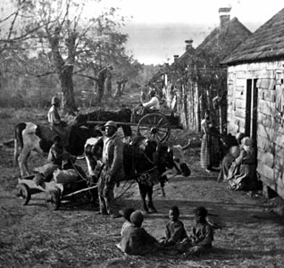
Slave Quarters on a South Carolina Plantation, 1860
“Our favorite way of sleeping, however,
was on a plank, our heads raised on an old jacket
and our feet toasting before the smoldering fire.”

Slide 31
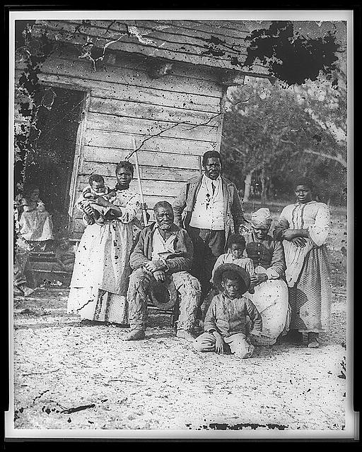
Five Generations at the Smith Plantation
“The wind whistled and the rain and snow blew in through the cracks, and the damp earth soaked in the moisture till the floor was miry as a pig- sty.”

Slide 32
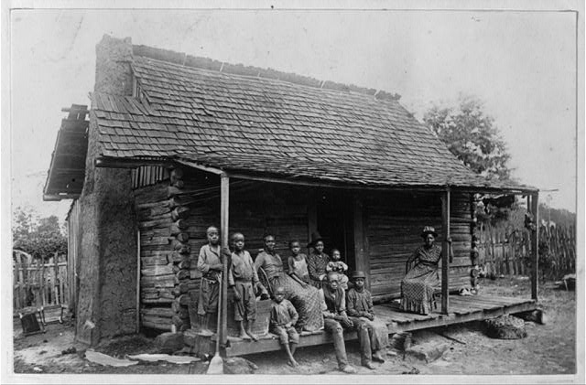
A Slave Cabin in Barbour County, near Eufala, Alabama
“Such were our houses. In these wretched hovels were we penned at night, and fed by day; here were the children born and the sick- - neglected.”

Slide 33
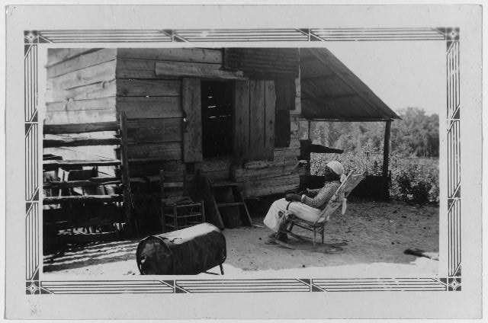
She uses the large battered tin can for a stove and does her cooking on it. Aunt Julia Ann is an ex-slave and was grown when the Civil "Wah broke out."
Julia Ann Jackson, Age 102 and the Corn Crib Where She Lives

Slide 34
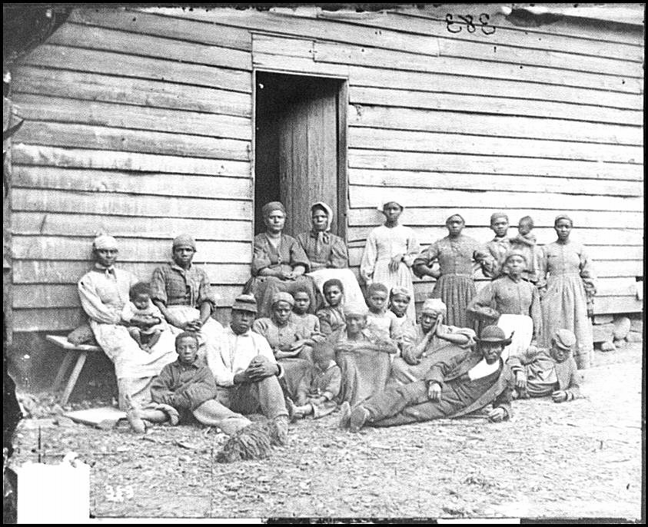
“In a single room were huddled, like cattle, ten or a dozen persons, men, women, and children.”

Slide 35
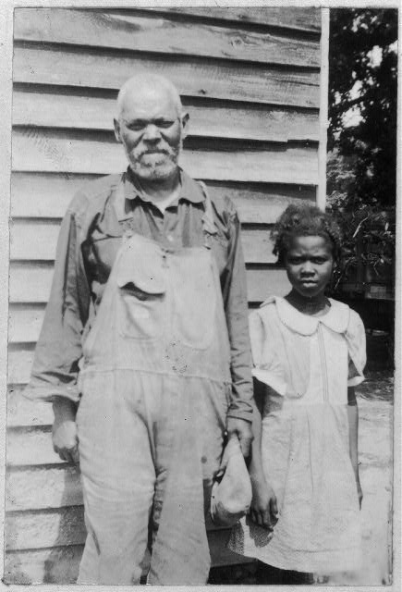
Charlie Crump and Granddaughter
“Our dress was of tow-cloth; for the children, nothing but a shirt; for the older ones a pair of pantaloons or a gown in addition, according to the sex.”

Slide 36
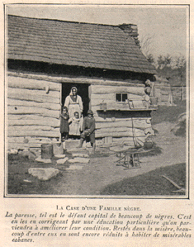
Slave Quarters
“Besides these, in the winter a round jacket or overcoat, a wool-hat once in two or three years, for the males, and a pair of coarse shoes once a year.”

Slide 37
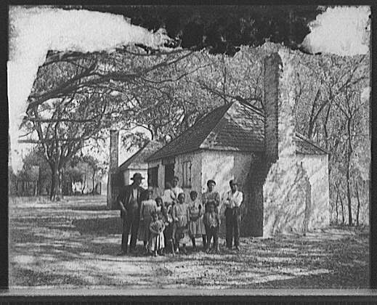
An African American Family, Outside the Slave Quarters
The Hermitage Plantation, Savannah, Georgia

Slide 38
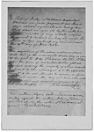
Paid by Judge S. Williams of Eufaula Dec. 20, 1849 for Jane, a woman aged 18 and her son Henry, one year old.
A Receipt for Six Hundred Dollars
For Children Who Might be Born in the Future

Slide 39
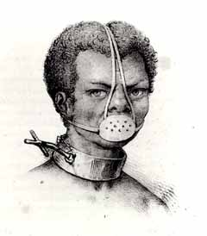
Muzzle used to prevent slave from eating or drinking too much.

Slide 40
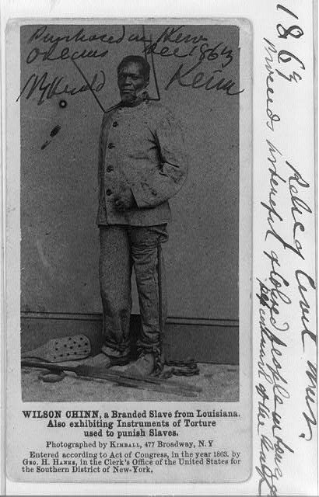
Wilson Chin, a branded slave in chains with various torture devices

Slide 41
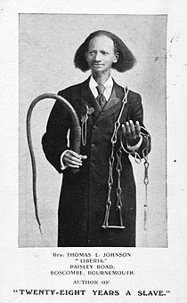
Rev. Thomas Johnson, who spent 28 years as a slave, holding the type of whip and chains that were used on him during his captivity.

Slide 42
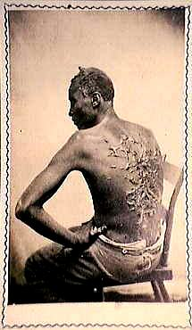

Slide 43
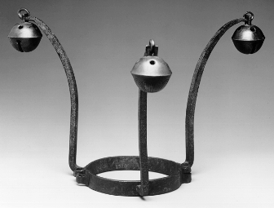
Slave Collar
c. 1840
The sound of this belled collar made any slave wearing it easier to locate. Resourceful slaves silenced the bells by stuffing them with mud.

Slide 44
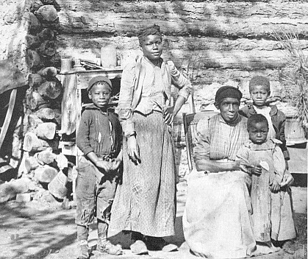

Slide 45
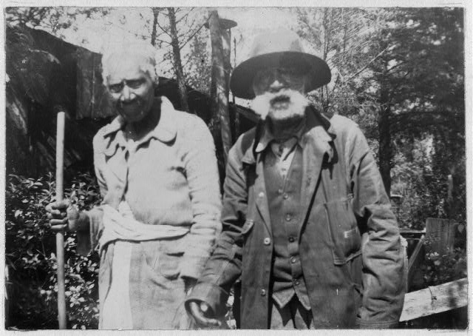
Richard and Drucilla Martin, Ages 92 and 102

Slide 46
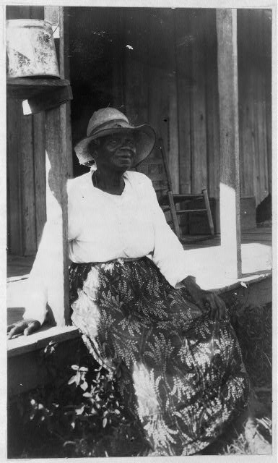
Mollie Williams,
Age 84

Slide 47
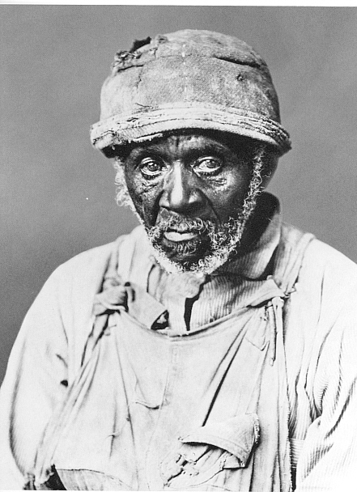

Slide 48
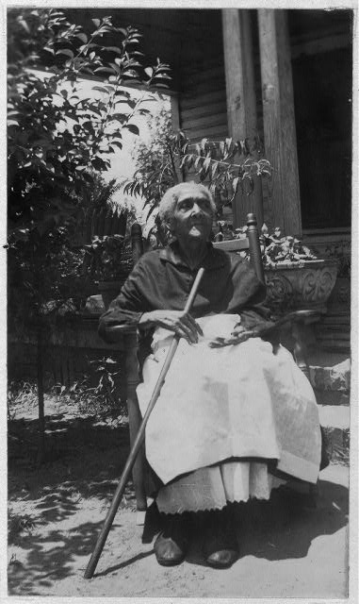
Tempie Herndon Durham,
Age 103

Slide 49
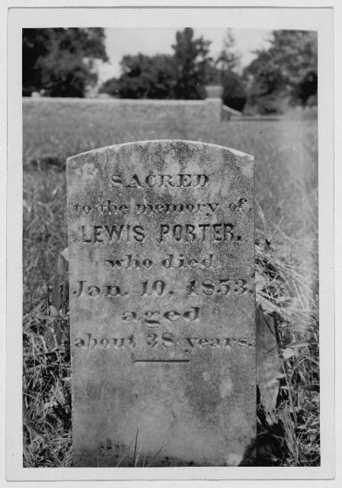
gravestone

Slide 50
Bibliography
http://blackhistory.eb.com/ | http://www.rev.net/~hmcmanus/slave.html
http://memory.loc.gov/ammem/snhtml/snintro01.html | http://lsm.crt.state.la.us/education/lesson9.htm
http://www.eca.com.ve/wtutor/juli/gallery.htm
http://www.pbs.org/wgbh/aia/part1/1h300.html
http://149.123.1.8/schomburg/images_aa19/slavery.cfm?sozl0636
http://www.spartacus.schoolnet.co.uk/USAShenson.htm
http://www.manznet.com/sycamore/newcivilpicturesofslavery.html
http://www.cms.ccsd.k12.co.us/ss/SONY/psbeta2/slavpho2.htm
http://www.angelfire.com/pa/doindunbar/slaves.html

