Slide 1
Slavery

Slide 2
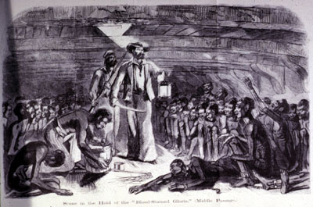
Capture and the Middle Passage
After capture, Africans were packed tightly into slave ships.
The death rate of the “passengers” was 50%.

Slide 3
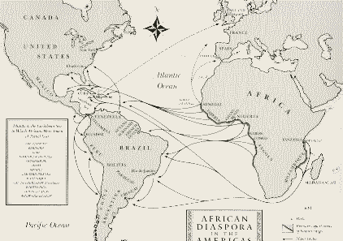
The Middle Passage

Slide 4
Destination, Auction, and Seasoning
Most Africans landed in Brazil with the least number landing in North America.
Slaves were auctioned off to the highest bidder.
Slaves were put through a process of “seasoning” to get them ready for work.
They learned an European language, were named an European name, and were shown labor requirements.

Slide 5
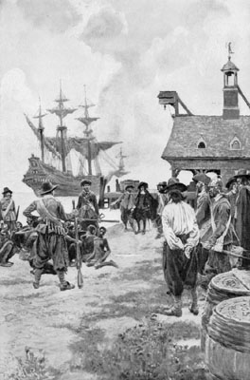
The Beginnings of Slavery in the United States
The Portuguese and Spanish had already brought Africans to South and Latin America.
In 1619, the first Africans were brought to the colony Jamestown, Virginia by the Dutch.

Slide 6
Why Not Enslave the Native Population?
Native Americans were highly likely to catch European diseases.
They were familiar with the terrain and could escape easier.
They had political allies that could fight against the “owners.”

Slide 7
Reasons for Using Enslaved African Labor
Proximity-It only took 2-6 weeks to get to the colonies from the Caribbean at first.
Experience-They had previous experience and knowledge working in sugar and rice production.
Immunity from diseases-Less likely to get sick due to prolonged contact over centuries.
Low escape possibilities-They did not know the land, had no allies, and were highly visible because of skin color.

Slide 8
Anthony Johnson
He was an African brought to the colonies in the 1620s.
He obtained his freedom, and purchased 250 acres of land in Virginia.
He owned at least one slave and white indentured servants.
This shows that blacks were not thought of strictly as slaves until the 1660s.

Slide 9
Slavery in the Colonies
New England colonies-no large plantation systems; slaves lived in cities and small farms
Chesapeake Bay colonies-large tobacco plantations; center of the domestic slave trade
Carolinas and Georgia-large rice and cotton plantations

Slide 10
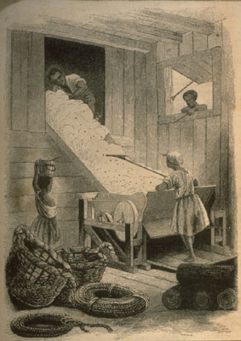
The Effects of the American Revolution and the Constitution
Gradual abolition of slavery in the northern colonies
End of the Atlantic Slave Trade in 1808
Entrenchment of slavery in the South with the invention of the cotton gin in 1793 by Eli Whitney

Slide 11
Life of a Slave
Most slaves had Sundays off and they went to church.
Most slaves could not read or write, and it was illegal for them to learn.
Slave Codes-They could not: leave their home without a pass, carry a weapon, gather in groups, own property, legally marry, defend themselves against a white person, or speak in court.

Slide 12
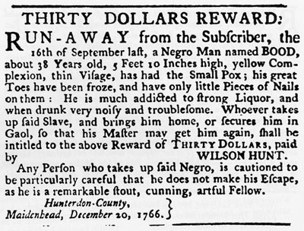
Resistance
Flight-Slaves would runaway.
Truancy-Flight for a short amount of time and then the slave came back.
Refusal to reproduce-Women refused to have children.
Covert Action-Slaves would sometimes kill animals, destroy crops, start fires, steal stuff, break tools, poison food.

Slide 13
Violence
4 major slave revolts-
  Stono Rebellion-failed revolt in South Carolina in 1739
  Gabriel Prosser-led failed revolt in Virginia in 1800
  Denmark Vessey-led failed revolt in South Carolina in 1822
  Nat Turner-killed 60 white people in Virginia in 1831

Slide 14

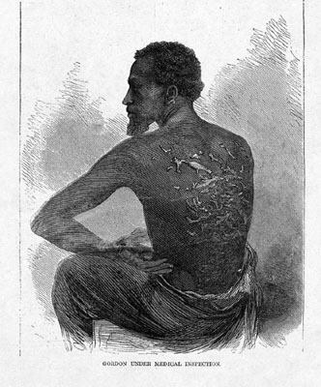
Punishment
Slaves were often brutally punished for misbehaving.
Punishments included: whipping, branding, being sold, gagged (silence), and other torturous methods were used.

Slide 15
Compromise of 1850
California comes in the Union (United States) as a free state
Utah and New Mexico territories are created-no mention of slavery
Outlaws slave trade in Washington, D.C.
Fugitive Slave Act-requires northerners to return escaped slaves to masters

Slide 16
The Dred Scott Decision
Dred Scott was a slave who was taken to a free territory by his owner.
He sued for his freedom because he lived in the free territory.
His case went all the way to the Supreme Court, where Scott loses because he was not considered a citizen, thus could not sue in federal court. (He was “property” and could be taken anywhere.)

Slide 17
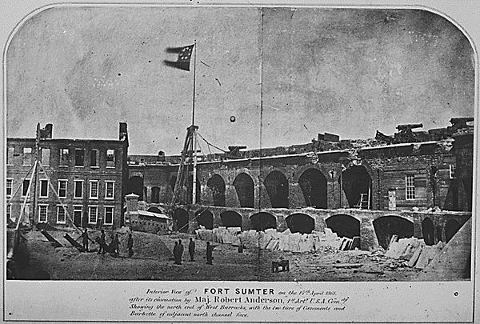
Election of 1860 and the Start of the Civil War
Abraham Lincoln was elected president in 1860 without any southern electoral votes.
Many southern states quickly seceded from the Union, South Carolina leading the way.
Southern troops fired upon Fort Sumter, starting the Civil War.
The North fought to preserve the Union, while the South fought to preserve slavery.

Slide 18
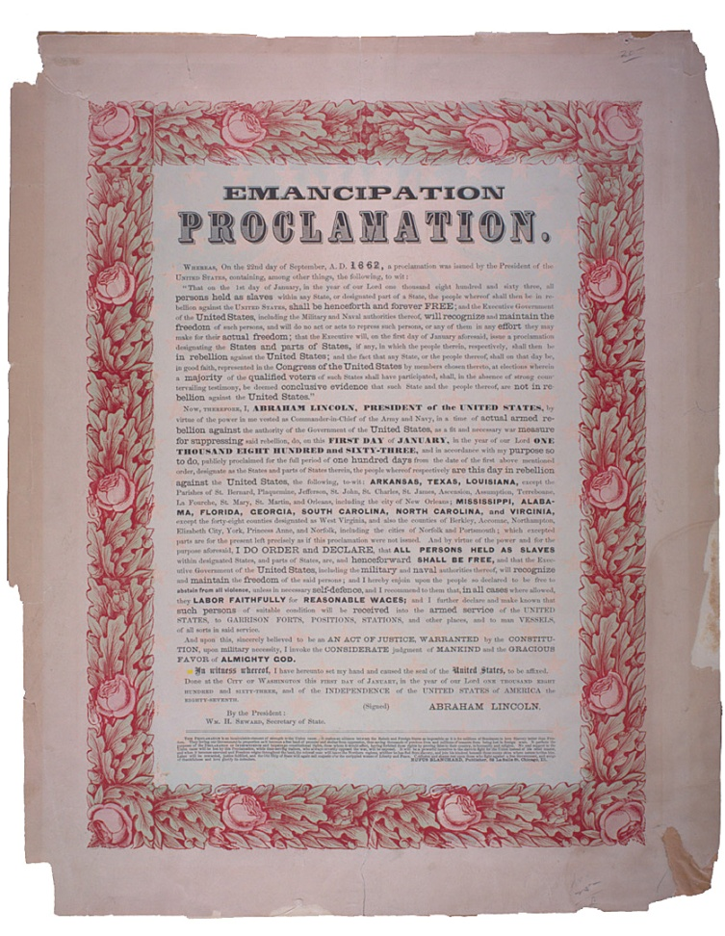
The Civil War and the Emancipation Proclamation
Early in the war, Lincoln began to think about ending slavery in the South to help end the war.
On September 22, 1862 he issued the Emancipation Proclamation which declared an end to slavery in the states in rebellion on January 1, 1863.
What did it do? Nothing. It only freed slaves in the states that had seceded.

Slide 19
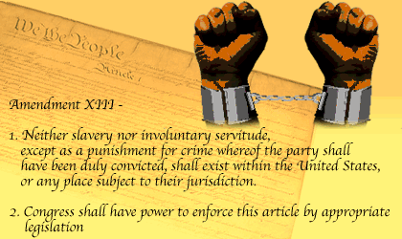
End of the Civil War and the 13th Amendment
The South lost, and the states were forced to accept the 13th Amendment to the Constitution before they could be readmitted into the Union.
13th Amendment-It abolished slavery in the United States.
It was ratified in 1865.

Slide 20


The End

