Slide 1
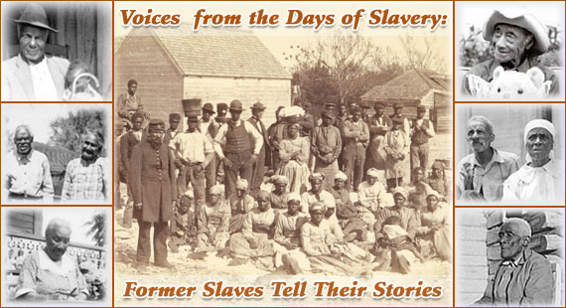
SLAVERY

Slide 2
The Beginning
Slavery began in the Americas in the early 1600’s.
Before Africans were brought over, the Native Americans were forced into slavery.
As most of the natives began dying out due to disease and harsh treatment, more slaves were needed.

Slide 3
The 1st slaves to be brought to North America came in 1619 to a tobacco farm in Virginia.
At first they were brought as an indentured servant, but later placed into slavery. An indentured servant must work for a certain number of years, but were then given freedom.

Slide 4
Slave traders learned quickly that they could make a lot of money in the business.
Once captured the slaves would board a ship on the West Coast of Africa.
The slaves ships were so crowded that many people had no room to breath. Sanitation became a problem.

Slide 5
Many died on the trip to the Americas.
Slaves ships docked in places like Savannah, Charleston, and New Orleans.
Prices ranged from a few hundred dollars to almost two thousand.

Slide 6
SLAVERY IN THE SOUTH
After the invention of the cotton gin by Eli Whitney in 1793, cotton became “king” in the south.
Plantations needed more workers, so the slave trade grew.

Slide 7
By 1860, the south was producing 4 million bales of cotton annually.
As the need for slaves increased, so did the value of a slave. Between 1800 and 1860, the value of an average field hand increased by 20 times the previous amount.

Slide 8
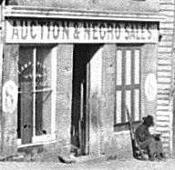
Slaves were bought and sold at slave auctions. Every major city in the south had an auction.

Slide 9
About 75% of all slaves were purchased as field hands. More than ½ of all slaves in the U.S. worked on cotton plantations in the south.
Some slaves were more fortunate. They might be employed as house servants or highly-trained craftsmen.

Slide 10
In 1790 GA had 29,264 slaves. By 1860, 70 years later, GA had 462, 198 slaves. Almost ½ of GA’s population were slaves.
Most people did not own very many slaves. Only one plantation in GA owned 500 or more slaves. Most people only owned 1-2. Only about 40% owned slaves.
GA ranked 2nd behind VA in # of slaves.

Slide 11
DAILY LIFE OF SLAVES
Slaves usually ate fatback, molasses, and cornbread. Some could grow a vegetable garden or fish in a stream or pond. Sometimes the owners gave them rabbits, opossums, squirrels, or other small game.

Slide 12
They wore clothing that would last a long time. Clothes did not always fit and many times the slaves worked barefoot. House slaves were sometimes given clothing that the owners no longer wore. These were much better than the clothing of the field hands.

Slide 13
Most slave housing was a one room wooden cabin with one door and one window with no glass. The floors were usually dirt and they had little furniture. Usually only a table, some chairs and pallets to sleep on.
All cooking and heating was done through the fireplaces that were built with sticks and dirt.

Slide 14
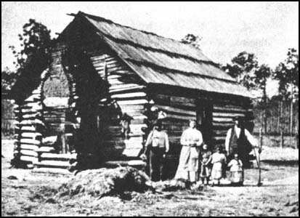

Slide 15
Work routines of the slaves was very demanding. Field hands worked six days a week, from sunrise to sundown.
They worked in rice, cotton, and tobacco fields.
Each slave had a certain amount to complete each day. If the slave did not complete this amount, the overseer might whip or punish him or her.

Slide 16
Besides working in the fields, the slaves also had to complete other odd jobs that needed to be done on the plantation.
Slave women worked in the fields, spent time spinning, sewing, weaving, preparing food, and minding children.

Slide 17
Children began work around 5-6 yrs. old.
They shooed chickens out of the garden and flies off the table, carried water to workers in the field, gathered nuts and berries, and collected firewood.
The overseer was hired by the owner to manage the slaves on a
day to day basis.

Slide 18
Overseers on large plantations were paid from $200 to $1,000 a year. They also usually got a house and a small plot of land.
Overseers usually carried whips and other means of punishment. A slave would be whipped if refusing to work.
They had to be careful not to over punish as not to injure a worker.

Slide 19
Overseers usually had a driver to help him. This was an older slave that could be trusted to help manage the other slaves.
Slaves did marry and have families. If a slave could not find a mate on a plantation, it was encouraged that the slave marry from an adjoining plantation. Any children became the property of the owner of the mother.

Slide 20
The law did not recognize slave marriages. Many times owners would separate slave families when slaves were sold. Slave owners would commonly threaten a slave by saying “I’m going to put you in my pocket.”

Slide 21
Slave Religion and Education
Religion became a great comfort to the slaves. In many areas, the slaves were allowed to hold their own church meetings.
Slaves sang spiritual hymns in church and while working.

Slide 22
Education was almost nonexistent for most slaves.
It was against the law for a slave owner to teach any slave to read or write. It was feared that if a slave could read and write, they might use their talents to stir up discontent among the slaves.
Some owners taught slaves simple words in order to help get supplies.

Slide 23
Music was a major part of the lives of the people in Africa.
Slaveholders feared the use of African drums on the plantations and prohibited their use.
They feared that they might be used to signal a slave revolt.
To continue using the rhythm of the drums, slave resorted to hand clapping, body slapping, and foot tapping.

Slide 24
SLAVE UPRISINGS
Slaves were not allowed to leave plantations unless with the owner, overseer or with a pass.
This made is impossible for slaves to have secret meetings to create a plan for escape.

Slide 25
Slave Codes took away all rights of slaves. The codes said:
It was illegal for a slave to testify against a white.
A slave could not show disrespect to a white.
Could not make any physical contact with a white.
Could not carry a weapon.

Slide 26
However even with all of the supervision, some slave uprisings did occur.
In 1800, Gabriel Prosser organized an uprising, but two of the slaves told their owners two hours before it was to take place.
Prosser was arrested and executed with 34 others.

Slide 27
In 1831, Nat Turner led the bloodiest slave revolt in American History. He was a slave preacher in Virginia. During attacks he and his followers killed between 57 and 65 white men, women, and children.
Turner and 20 others were killed.

Slide 28
ABOLISTIONISTS
Many people wanted to get rid of slavery. These people were called abolitionists.
They made speeches, wrote books and articles, and offered their homes as a safe house to runaway slaves.

Slide 29
William Lloyd Garrison published a newspaper called The Liberator, which urged freedom for all people.
Harriet Beecher Stowe wrote about slaves in Uncle Tom’s Cabin.
The best known abolitionists was a former slave, Frederick Douglas.

Slide 30
Douglas printed a newspaper titled North Star. He also gave many speeches about slavery.
Sojourner Truth, another freed slave, also gave many speeches.
Harriet Tubman helped many slaves escape on the underground railroad.

Slide 31
This was a chain of homes, farms, and churches were runaway slaves could rest and hide from slave catchers.
The slaves continued running until they reached a free state or Canada.
Around 50,000 slaves escaped on the underground railroad between 1830-1860.

Slide 32
GA’s attitude toward slavery.
While only 40% of population owned slaves, the worth of the slaves ran into millions of dollars.
A few whites spoke out against slavery, but most felt that it was the way of life.

Slide 33
Many felt that they were helping to care for the blacks and teaching them Christianity.

