Slide 1
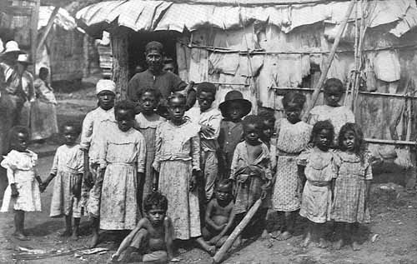
Colonial Slavery Why did slavery come to the American Colonies?

Slide 2
Initially, slavery was not the dominant system of labor for the colonies. It was Indentured Servitude.
Headright System: Plantation owners were given 50 acres for every indentured servant they sponsored to come to America from Europe.
Indentured Contract: Served plantation owner for 7 years as a laborer in return for passage to America.
Freedom Dues: Once servant completed his contract, he/she was freed….They were given land, tools, seed and animals. However, they did not receive voting rights.

Slide 3
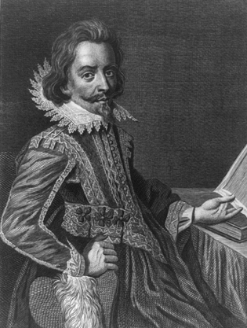
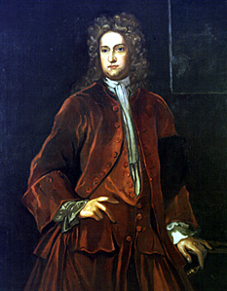
Bacon’s Rebellion (1676 - 1677)
Nathaniel Bacon represents former indentured servants.
Governor William Berkeley of Jamestown

Slide 4
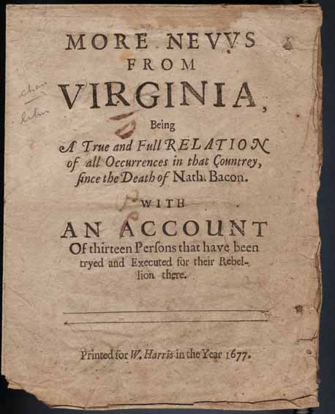
BACON'S REBELLION
Involved former indentured servants
Not accepted in Jamestown
Disenfranchised and unable to receive their land
Gov. Berkeley would not defend settlements from Indian attacks

Slide 5
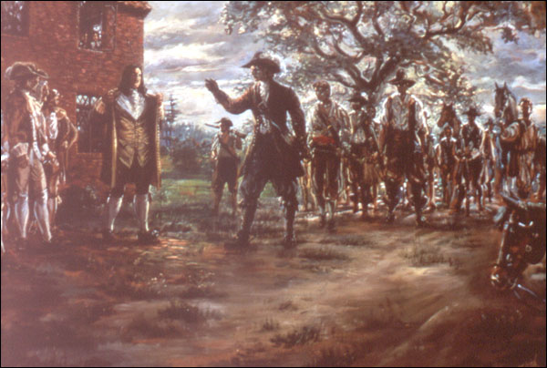
BACON'S REBELLION
Nathaniel Bacon acts as the representative for rebels
Gov. Berkeley refused to meet their conditions and erupts into a civil war.
Bacon dies, Gov. Berkeley puts down rebellion and several rebels are hung
Consequence of Bacon’s Rebellion Plantation owners gradually replaced indentured servants with African slaves because it was seen as a better investment in the long term than indentured servitude.

Slide 6
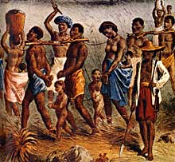
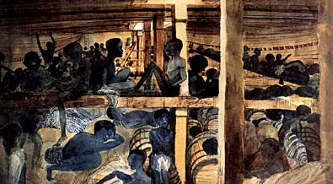
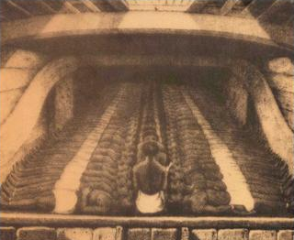
HOW SLAVERY CAME TO THE U.S.
Slavery introduced by the Spanish into the West Indies after Columbus’s discovery of America.
Spanish and Portuguese expanded African slavery into Central and South American after enslaved Indians began dying off.
In 1619, the first recorded introduction of African slaves into what would become the United States was in the settlement of Jamestown……Only 20 slaves were purchased….
Slaves captured in Africa
Slaves aboard ship—Middle Passage

Slide 7
Why Not Enslave the Native Population?
Native Americans were highly likely to catch European diseases.
They were familiar with the terrain and could escape easier.
They had political allies that could fight against the “owners.”

Slide 8
Reasons for Using Enslaved African Labor
Proximity-It only took 2-6 weeks to get to the colonies from the Caribbean at first.
Experience-They had previous experience and knowledge working in sugar and rice production.
Immunity from diseases-Less likely to get sick due to prolonged contact over centuries.
Low escape possibilities-They did not know the land, had no allies, and were highly visible because of skin color.

Slide 9
The Triangular Trade
New England merchants gain access to slave trade in the early 1700s
Rum brought to Africa, exchanges for slaves
Ships cross the Middle Passage, slaves trades in the West Indies.
Disease, torture, malnourishment, death for slaves
Sugar brought to New England
Other items trades across the Atlantic, with substantial profits from slavery making merchants rich

Slide 10
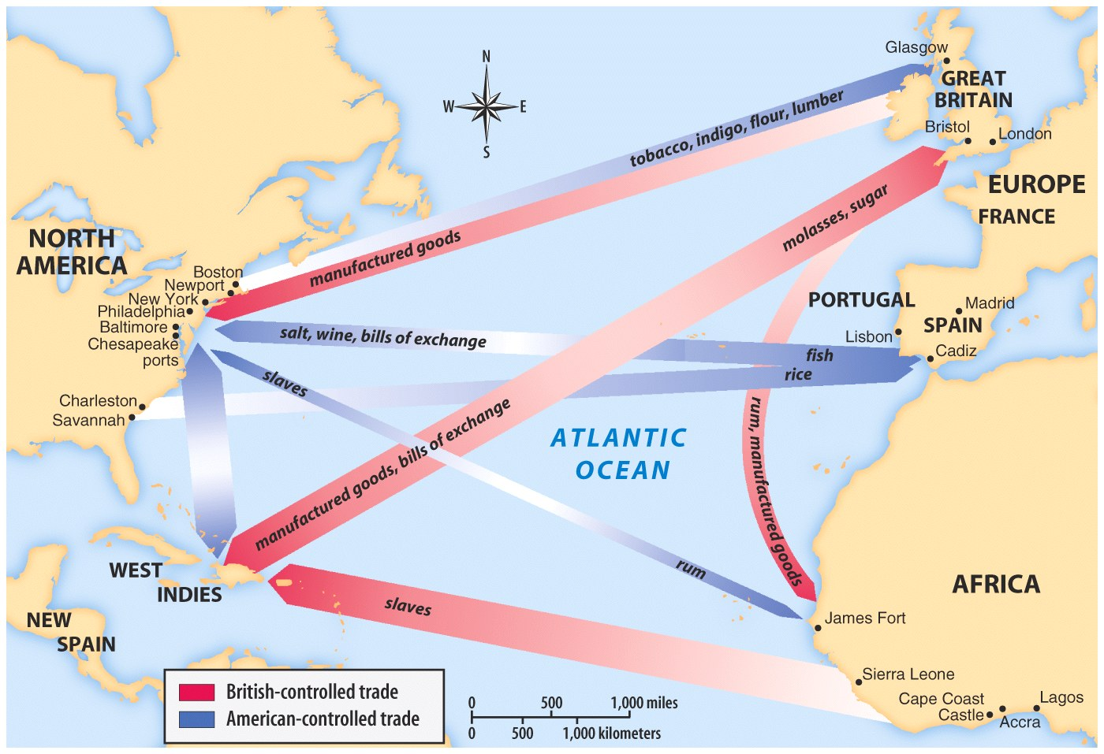
Manufactured Goods
Furniture
Clothing
Colonials had not factories.
From England to Colonies

Slide 11
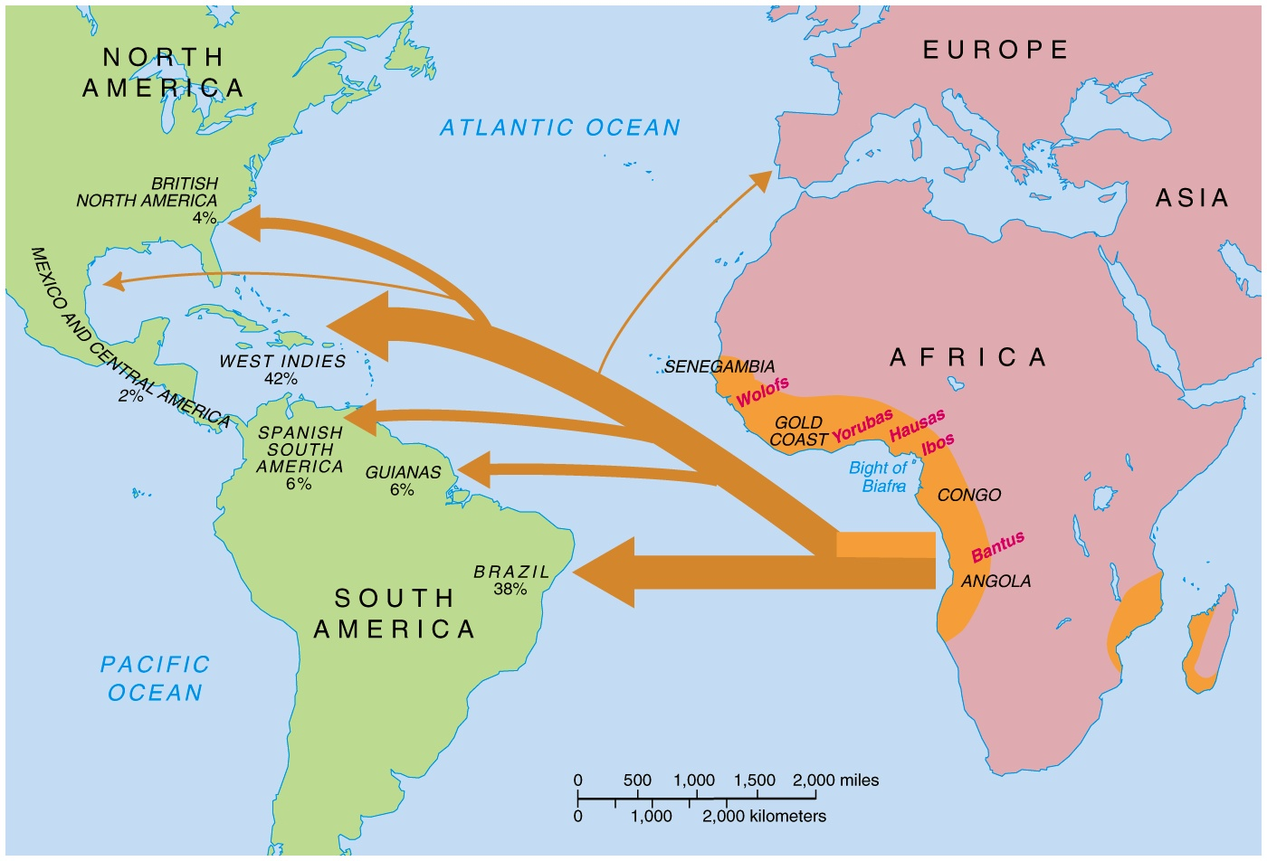
BEGINNINGS OF SLAVERY
This is called the Middle Passage

Slide 12
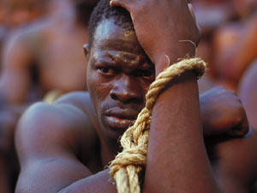
Middle Passage
http://youtu.be/TgTGiWeRCWc

Slide 13
Destination, Auction, and Seasoning
Most Africans landed in Brazil with the least number landing in North America.
Slaves were auctioned off to the highest bidder.
Slaves were put through a process of “seasoning” to get them ready for work.
They learned an European language, were named an European name, and were shown labor requirements.

Slide 14
Slavery and the Colonies
Slavery in the North
Since the economics of New England and the Middle Colonies were based on small farms, slavery was far less important
Given that slaves were few and posed little threat to the white majority, laws were less harsh than in the South
Slaves did represent a sizable percentage of urban laborers, particularly in New York and Philadelphia

Slide 15
Slavery in the Colonies
New England colonies-no large plantation systems; slaves lived in cities and small farms
Chesapeake Bay colonies (NY, Penn, WV, Virg, Delaware)--large tobacco plantations; center of the domestic slave trade
Carolinas and Georgia-large rice and cotton plantations

Slide 16
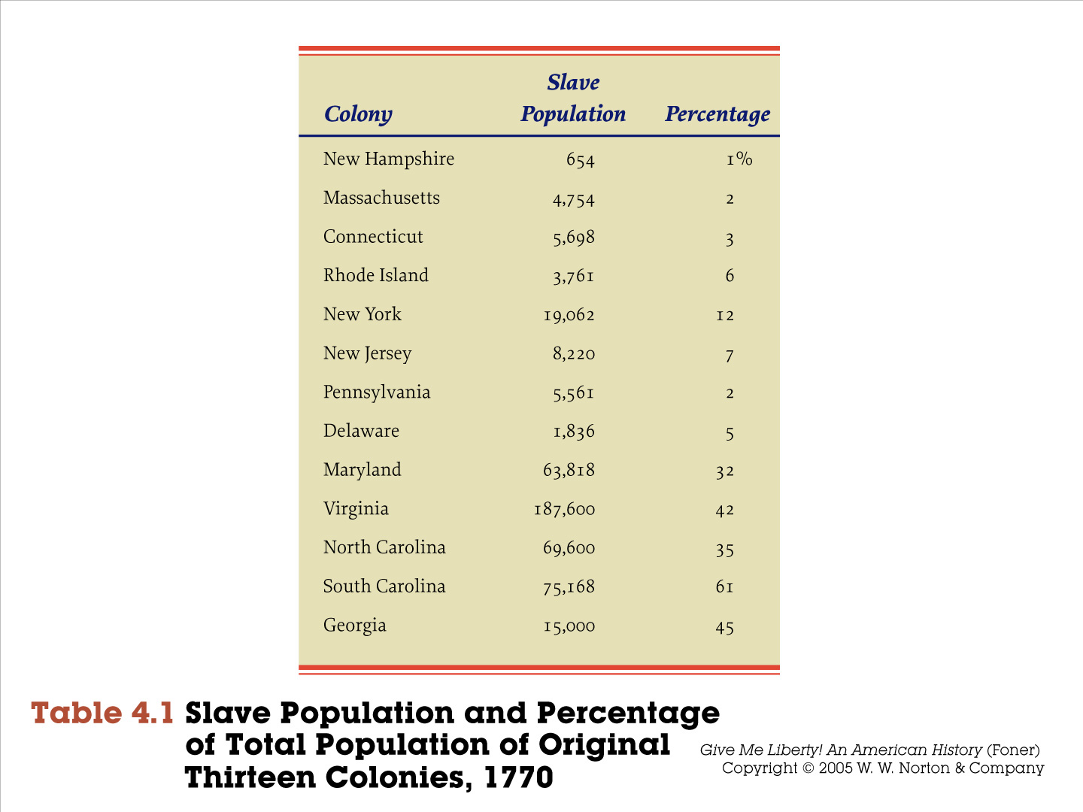
Slavery and the British Empire
Slave Systems in the English Colonies
Three distinct slave systems were well entrenched in Britain’s mainland colonies
Chesapeake
South Carolina and Georgia
Non- plantation societies of New England and the Middle Colonies
Chesapeake slavery was based on tobacco
Chesapeake plantations tended to be smaller and daily interactions between masters and slaves were more extensive

Slide 17
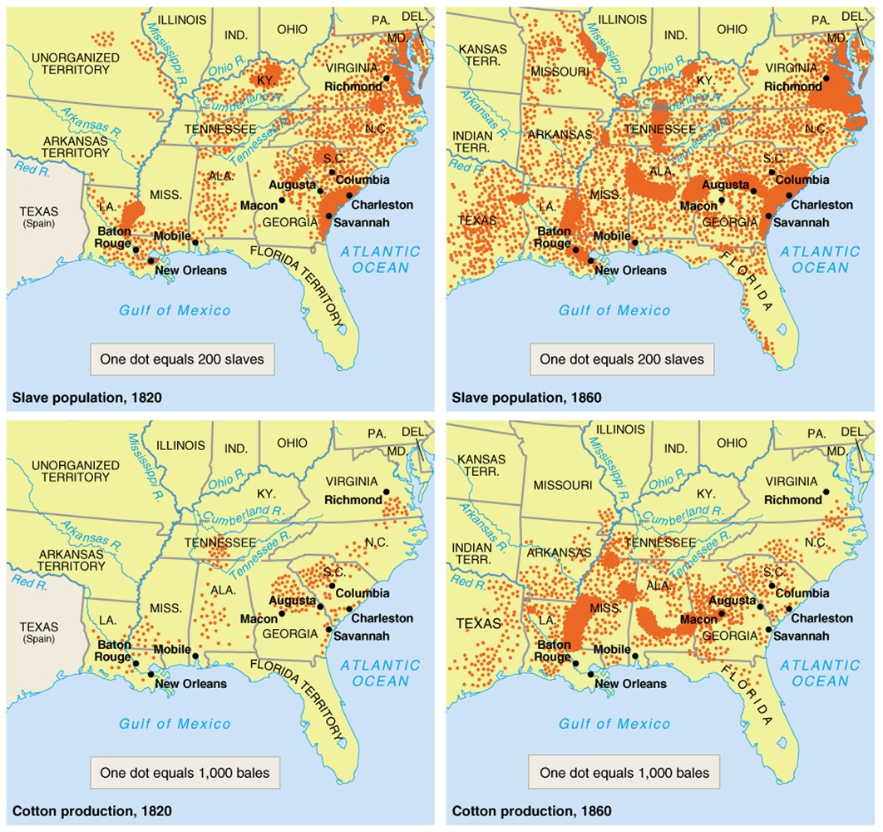
GROWTH OF SLAVERY

Slide 18
GROWTH OF SLAVERY

Slide 19

Slave Revolts
SLAVE REVOLTS
Slaves resorted to revolts in the 13 colonies and later in the southern U.S.
250 insurrections have been documented; between 1780 and 1864.
91 African-Americans were convicted of insurrection in Virginia alone.
First revolt in what became the United States took place in 1526 at a Spanish settlement near the mouth of the Pee Dee River in South Carolina.

Slide 20
Slave Laws
SLAVE CODES AND LAWS
Slave Revolts would lead plantation owners to develop a series of slave laws/codes which restricted the movement of the slaves.
Slaves were not taught to read or write
Restricted to the plantation
Slaves could not congregate after dark
Slaves could not possess any type of firearm
A larger slave population than white in some states
Slave owners wanted to keep their slaves ignorant of the outside world because learning about life beyond the plantation could lead to more slave revolts and wanting to escape.

