Slide 1
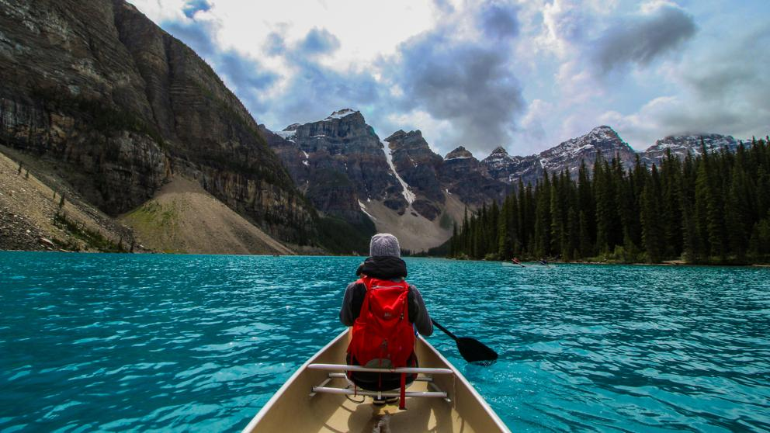
Canada

Slide 2
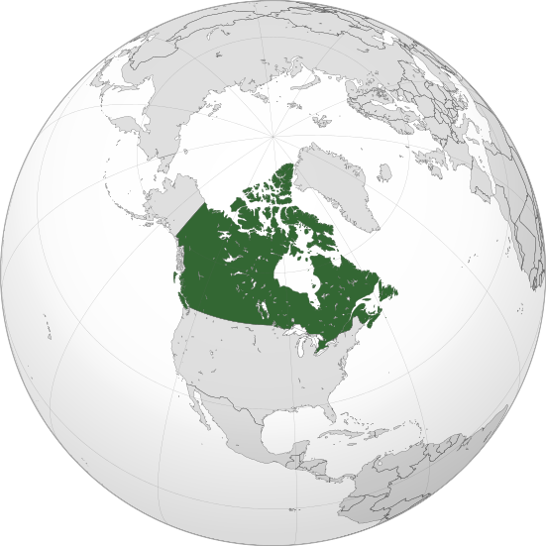

Slide 3
Canada is a country located in the northern part of North America. Its ten provinces and three territories extend from the Atlantic to the Pacific and northward into the Arctic Ocean, covering 9.98 million square kilometres , making it the world's second-largest country by total area. Canada's southern border with the United States is the world's longest bi-national land border. As a whole, Canada is sparsely populated, the majority of its land area being dominated by forest and tundra. Consequently, its population is highly urbanized, with 82 percent of the 35.15 million people concentrated in large and medium-sized cities, many near the southern border. Its capital is Ottawa, and its three largest metropolitan areas are Toronto, Montreal, and Vancouver.

Slide 4
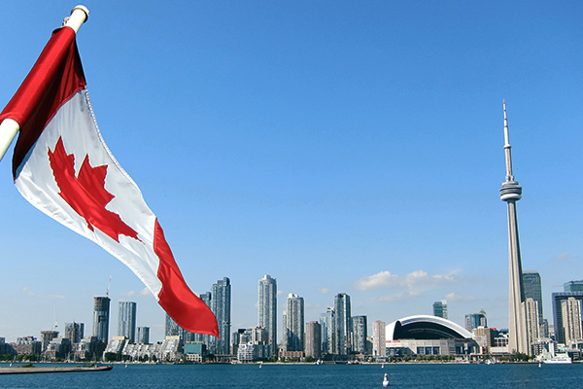
Canada is the second largest country in the world with only Russia being larger. With an estimated three million lakes in Canada, there is more surface area of water in Canada than any other country.

Slide 5
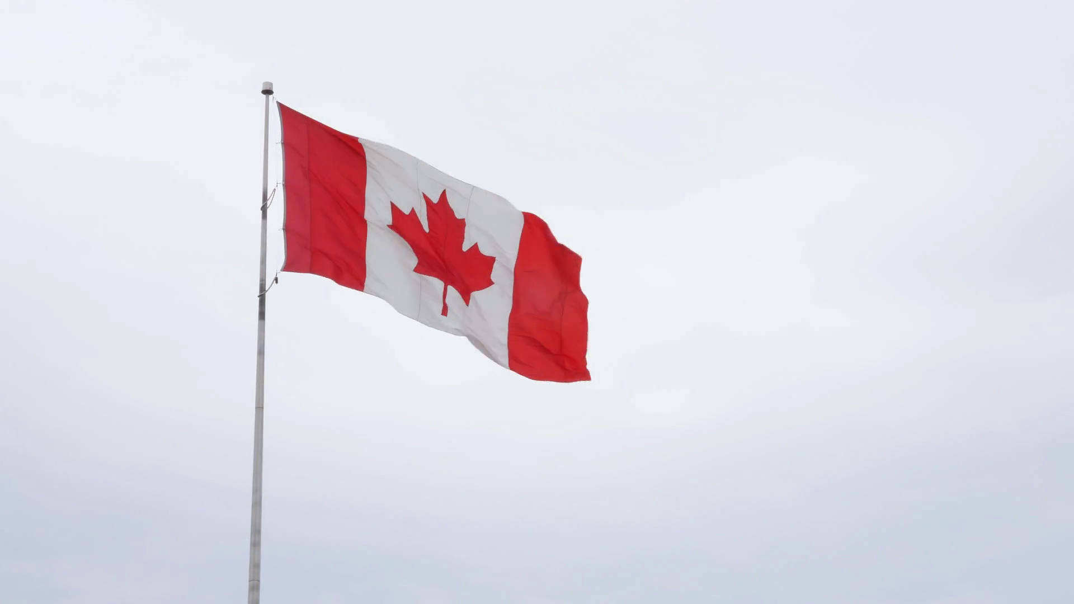
Key Facts:
Capital: Ottawa
Population: 35,151,728 people
Total area: 9.9 million sq. km
Became a country: July 1st, 1867
Borders: The United States
Official languages: English and French
Government: Federal parliamentary
Currency: Canadian dollar (CAD)

Slide 6
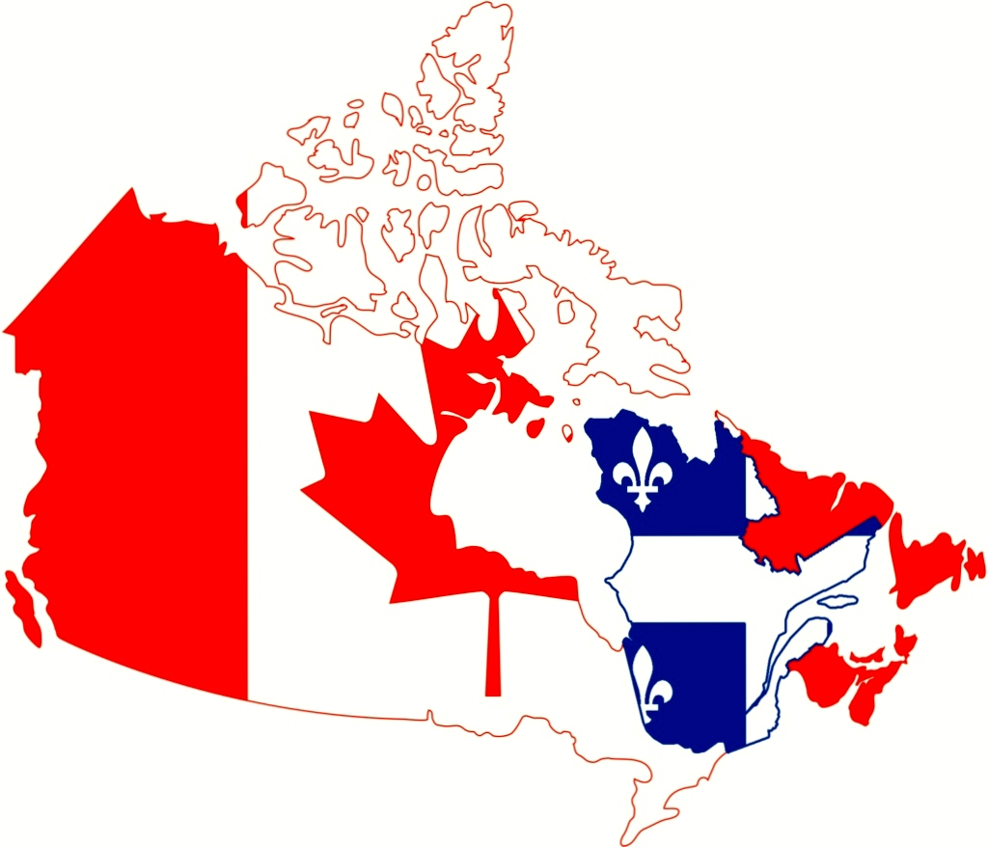
Languages of Canada
Canada has two official languages, those being English, (59%), and French (22%). In addition to these, the next most widely spoken languages are Punjabi, Italian, Spanish, German, Cantonese, Tagalog and Arabic, all of which are spoken by 1-2% of the population.

Slide 7
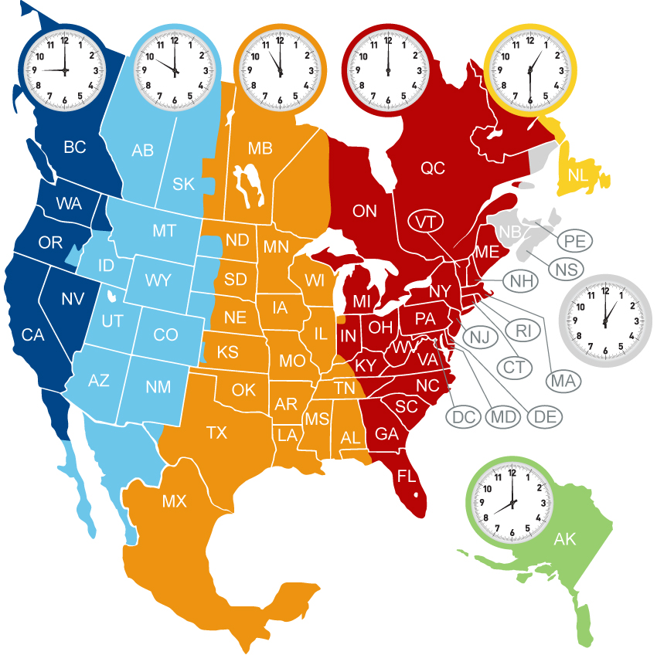
Timezone
Being such a large country, it comes as no surprise that Canada has six time zones. The decision on whether to have daylight savings time is delegated down to the provincial governments so there is also a great variety in whether places choose to follow daylight saving or not

Slide 8
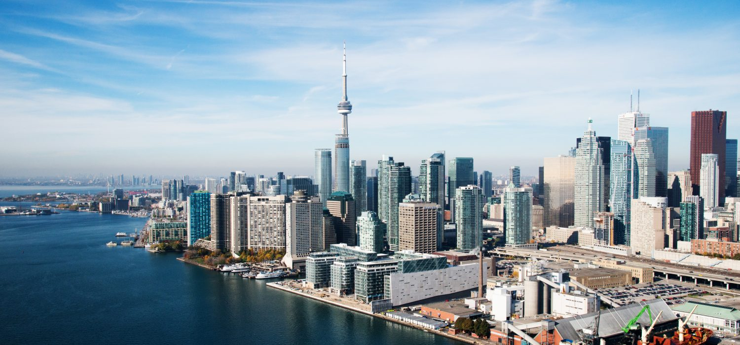
Most people in Canada live in major cities such as Toronto, Vancouver, Montreal, and Calgary.
The weather in Canada changes from region to region. Canada generally experiences cold winters and hot summers.
On the west coast lie the Rocky Mountains, and in the Province of Ontario are 5 freshwater lakes called the Great Lakes.
Canada is geologically active and has many earthquakes and active volcanoes. It is also home to Niagara Falls.
Canada is rich in natural resources like zinc, nickel, lead, and gold.

Slide 9
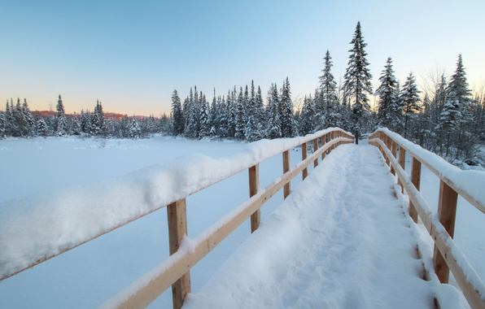
Canada's large size gives it a wide variety of landscapes from the temperate in the south to the positively Arctic in the North. Canada has the northernmost settlement in the world. Landlocked places tend to have warm, continental summers and the temperatures can reach 40 degrees celsius in the summer. In the winter, it has got as low as -65 degrees celsius.

Slide 10
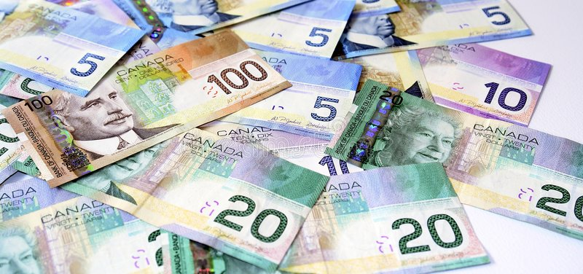
In Canada, the Canadian Dollar is used for currency.

Slide 11
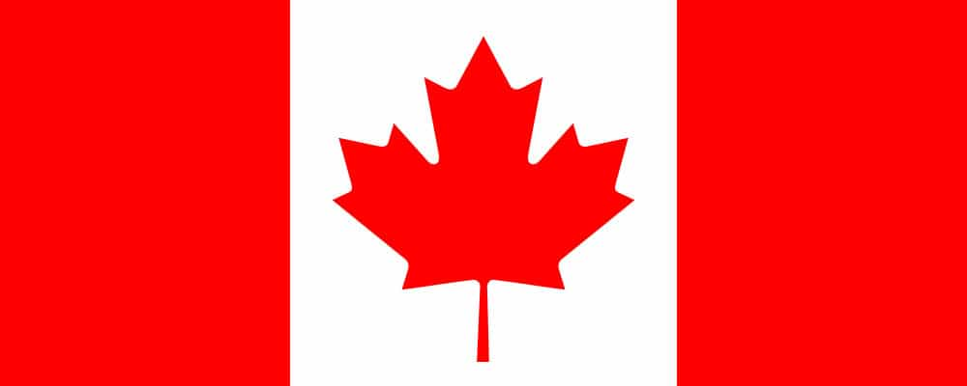

Slide 12
Various indigenous peoples have inhabited what is now Canada for thousands of years prior to European colonization. Beginning in the 16th century, the British and French established colonies, the first being the colony of Canada established by France in 1535. As a consequence of various armed conflicts, British North America gained and lost territory until, by the late 18th century, it controlled most of what comprises Canada today. On July 1, 1867, the colonies of Canada, New Brunswick, and Nova Scotia were federated to form the semi-autonomous federal Dominion named Canada. This began an accretion of provinces and territories to the Dominion to the present ten provinces and three territories forming contemporary Canada. Canada achieved independence gradually beginning with responsible government in the 1830s and culminating with the patriation of the Constitution in 1982. In 1931, Canada achieved near-total independence from the United Kingdom with the Statute of Westminster 1931, except for the power to amend its constitution.

Slide 13
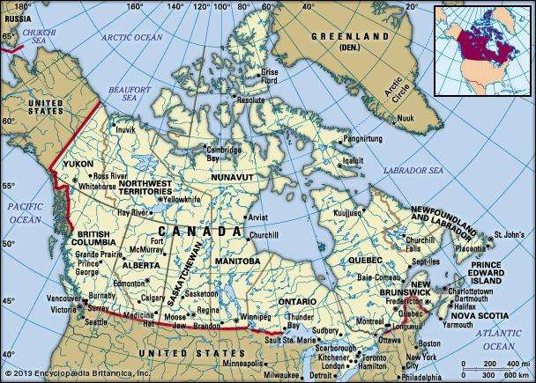

Slide 14
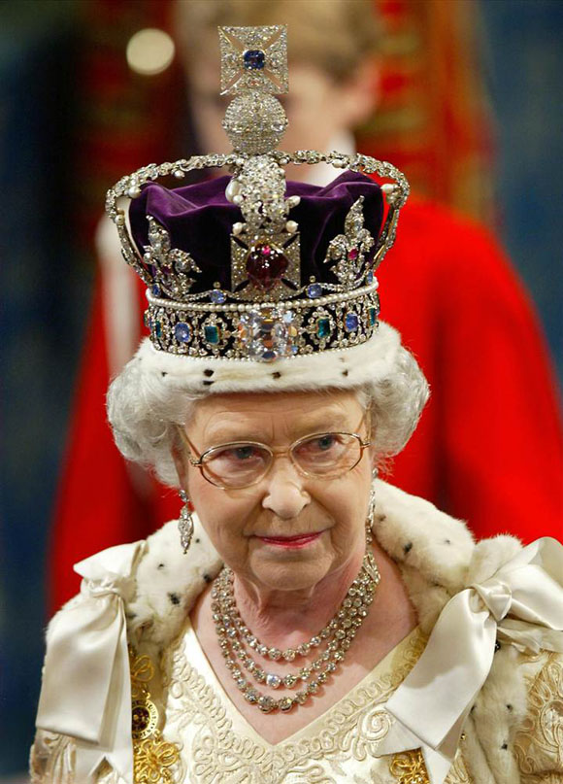
Politics of Canada
Canada has a parliamentary system within the context of a constitutional monarchy, the monarchy of Canada being the foundation of the executive, legislative, and judicial branches. The Canadian monarchy is a separate legal institution from the monarchy of the United Kingdom, though the two offices are held by the same individual. The sovereign is Queen Elizabeth II, who is also monarch of 15 other Commonwealth countries and each of Canada's 10 provinces. As such, the Queen's representative, the Governor General of Canada (at present Julie Payette), carries out most of the federal royal duties in Canada.

Slide 15
Canada is a developed country and has the fifteenth-highest nominal per capita income globally as well as the tenth-highest ranking in the Human Development Index. It ranks among the highest in international measurements of government transparency, civil liberties, quality of life, economic freedom, and education. Canada is a realm within the Commonwealth of Nations, a member of the Francophonie, and part of several major international and intergovernmental institutions or groupings including the United Nations, the North Atlantic Treaty Organization, the G7 (formerly G8), the Group of Ten, the G20, the North American Free Trade Agreement and the Asia-Pacific Economic Cooperation forum.

Slide 16
‘Etymology’
While a variety of theories have been postulated for the etymological origins of Canada, the name is now accepted as coming from the St. Lawrence Iroquoian word kanata, meaning "village" or "settlement". In 1535, indigenous inhabitants of the present-day Quebec City region used the word to direct French explorer Jacques Cartier to the village of Stadacona.Cartier later used the word Canada to refer not only to that particular village but to the entire area subject to Donnacona (the chief at Stadacona) by 1545, European books and maps had begun referring to this small region along the Saint Lawrence River as Canada.

Slide 17
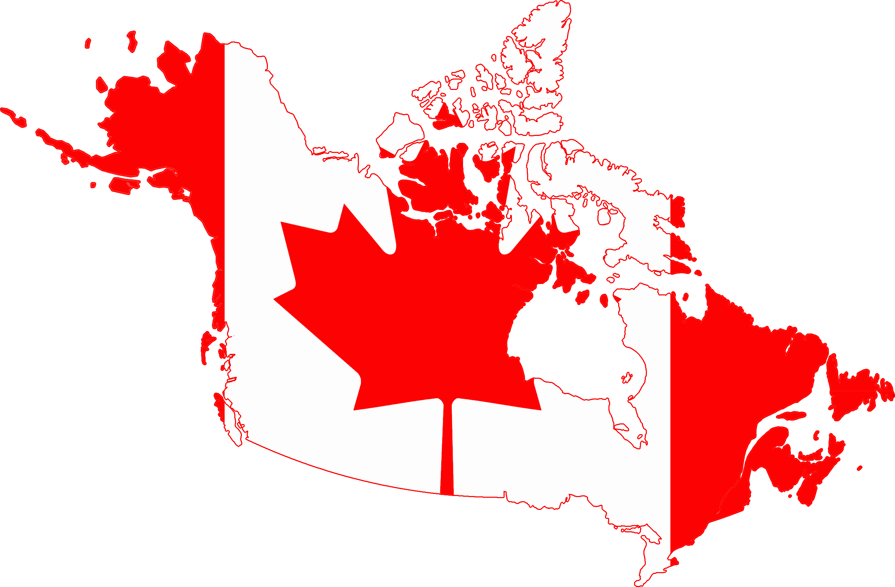
From the 16th to the early 18th century "Canada" referred to the part of New France that lay along the Saint Lawrence River. In 1791, the area became two British colonies called Upper Canada and Lower Canada collectively named the Canadas; until their union as the British Province of Canada in 1841. Upon Confederation in 1867, Canada was adopted as the legal name for the new country at the London Conference.

Slide 18
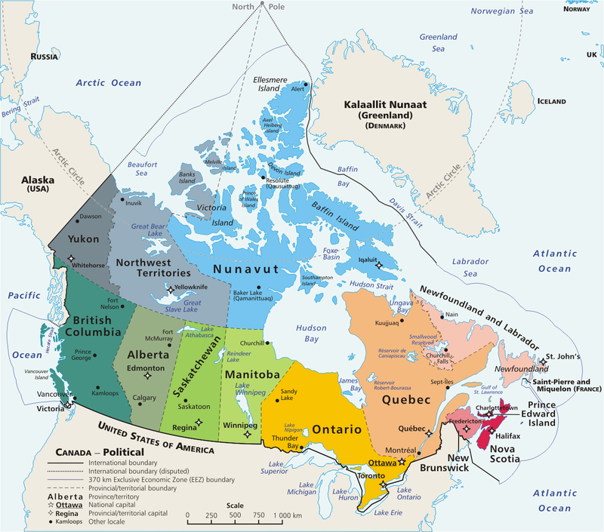

Slide 19
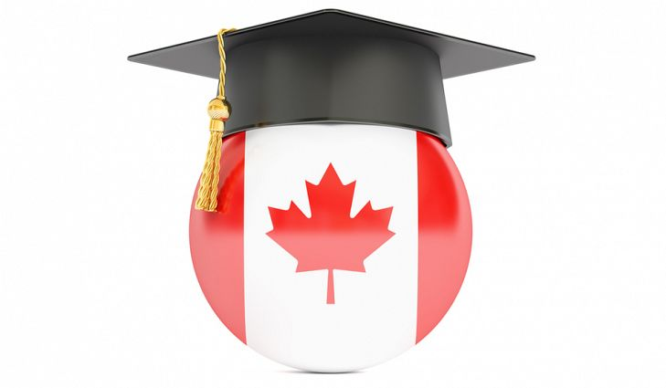
By law, children in Canada must go to school. Depending on the province or territory, children may start at the age of 5 or 6 and continue until they are between 16 and 18.
Schools in Canada:
start with kindergarten and continue to grades 1 to 12
usually begin at the end of August and finish around the end of June
run from Monday to Friday during the school year (except during holidays)
give high school diplomas to students who successfully complete secondary school (high school)
can be found in English-language and French-language across the country (even in areas where one language is more commonly spoken than the other)
It’s up to parents to choose the type of schooling for their children, such as:
free public schools
paid private schools
at-home education
English or French schools (in many areas)

Slide 20
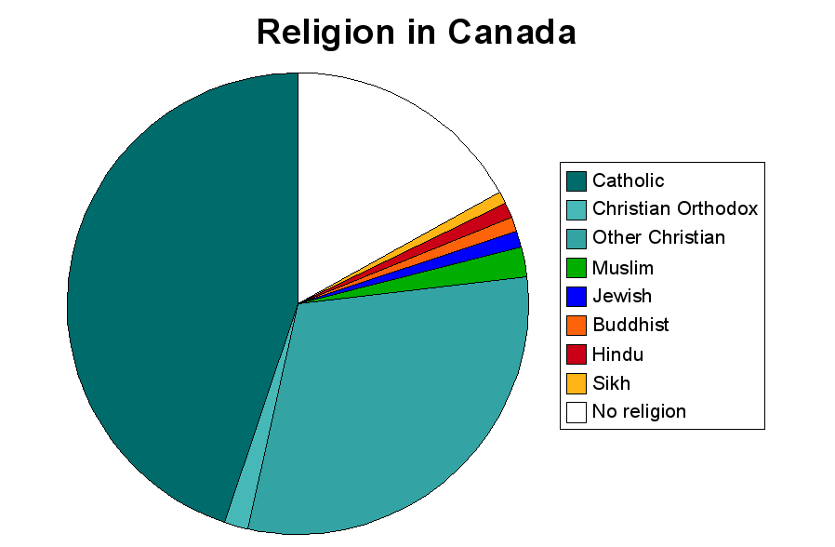
Canada has no official church, and encompasses many religions.

Slide 21

Culture of Canada: The Arts
Just as they are in the United States and Western Europe, most artists in Canada are “self-supporting,” although only a small minority draws their entire income from their artistic efforts. There are, however, several tax-funded programs, at all levels of the Canadian government, designed to support the arts and provide financial assistance to artists of all types. The Governor General’s Awards are presented each year to artists, writers, musicians, and other performers. There is also a federal National Art Gallery, and most provinces have one major tax-funded art gallery, usually in the provincial capital.

Slide 22
Canadian Literature
Unlike Europe and the United States, Canada does not have a single national literary tradition, but participates instead in the wider English world of literature. Of course there are many internationally renowned authors from Canada, but in general there is no single canon yet of Canadian literature as a whole. One exception to this rule is the province of Quebec, where there is a venerable “national” literature renowned for its social criticism and experimentation.
In the last 30 years, the number of published Canadian writers has increased dramatically, and as a cultural point, the Canadian community buys and reads more books than those in most other industrialized nations. Nonetheless, no special preference has yet to be given to Canadian literature.

Slide 23
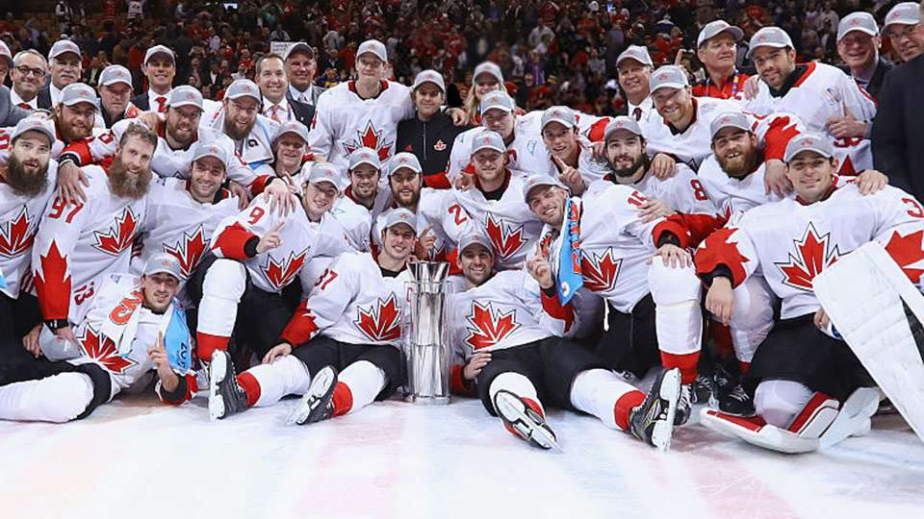
Sports are very popular in Canada, from both a participation and spectator standpoint. Canadians hold many sports dear, particularly the country’s two national sports: ice hockey and lacrosse.

Slide 24
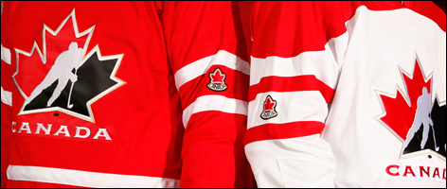
Referred to as simply “hockey” in Canada, ice hockey is the most popular and prevalent winter sport activity, and Canada’s most successful sport in terms of international competition. Many Canadian boys (and some girls) learn hockey at a very young age. Competitions are held for almost every age group, including high school and college, where participants dream of one day skating for their favorite team in the National Hockey League (NHL), which draws millions of Canadians spectators each year.
Similar to hockey, lacrosse is a sport with Native American origins and the official summer sport of Canada.

Slide 25
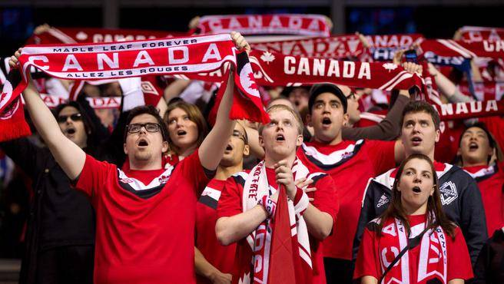
Canadian football is also popular in Canada, the second-most popular spectator sport in the country after hockey. Thousands compete in the Canadian Football League (CFL) each year, and its annual championship, the Grey Cup, is the country’s largest annual sports event.
Other sports gaining in popularity in Canada, particularly from a participation perspective, include Association football (soccer), golf, swimming, basketball, baseball, volleyball, skiing, cycling and tennis. As you might expect based on its colder climate, Canada has enjoyed greater success at the Winter Olympic Games than it has at the Summer Olympics.

Slide 26
Culture of Canada: Holidays and Celebrations
The people of Canada enjoy a number of important holidays and celebrations. Some of these are uniquely Canadian, while others have their roots in English and French traditions.28 Some of the most significant holidays and celebrations include:
Feast of the Assumption of the Blessed Virgin Mary. Celebrated every August 15th by the Canadian religious group known as the Acadians, this feast day is one of the most important observances of their religious calendar.
Boxing Day. Deriving its name from the 19th century English, Boxing Day occurs on December 26, when it was customary to give boxes or money to servants and family. The day used to be known as St. Stephens Day.
Canada Day. Canada day is the celebration of the nation’s birthday. The first Canada day (once known as Dominion Day) was celebrated on July 1, 1867.
Icelandic Festival. Also known as "Islendingadagurinn," the Icelandic Festival, a Viking-themed carnival day, has been celebrated in Canada since 1890.
Remembrance Day. Celebrated every November 11th, Remembrance Day is a holiday designed to honor the war veterans of Canada who were lost during the two World Wars.

Slide 27

Food
One truly Canadian food is “poutine,” thought to be invented in Quebec during the 1950s. In its original form, poutine consisted of a mixture of French fries generally slathered in gravy and cheese curds. Since its inception, however, the recipe has been regularly embellished and adapted in many odd and tasty ways, from the gourmet versions with lobster and foi gras added, to the quirky “donut” version of the recipe. Many restaurants and snack shops throughout Canada specialize in this traditional—and traditionally delicious—Canadian food.

Slide 28
Like their U.S. neighbors to the south, more and more Canadians are striving to eat a healthier diet these days, one often consisting of more ethnic foods, while balancing their love for baked goods and other comfort food items. In addition to Canadian bacon, maple syrup, Poutine and sushi pizza, a few of these favorite foods include:
Ketchup Chips. Chips slathered in ketchup are just one of the guilty-pleasure snacks enjoyed by Canadians.
Butter Tarts. A butter tart is a classic Canadian dessert made with butter, sugar, syrups and eggs, all filled in a buttery pastry shell that often includes raisins and nuts.
Beaver Tails. Before you shriek in disgust, Canadian Beaver Tails are merely a trademarked type of pastry widely distributed throughout the country. The fried dough treats are shaped to resemble a real beaver’s tail and are often topped with chocolate, candy and fruit.
Game Meat. Game meat makes up a significant part of the average Canadian’s diet, and is abundant in the country’s restaurants and butcher shops. Among other popular Canadian game meat is wild boar, bison, venison, caribou and rabbit.

Slide 29
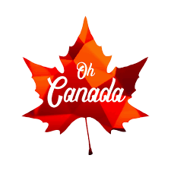
The Canadian music industry is the sixth-largest in the world producing internationally renowned composers, musicians and ensembles. Music broadcasting in the country is regulated by the CRTC. The Canadian Academy of Recording Arts and Sciences presents Canada's music industry awards, the Juno Awards, which were first awarded in 1970. The Canadian Music Hall of Fame established in 1976 honours Canadian musicians for their lifetime achievements. The national anthem of Canada, "O Canada" (1812), was originally commissioned by the Lieutenant Governor of Quebec, the Honourable Théodore Robitaille, for the 1880 St. Jean-Baptiste Day ceremony, and was officially adopted in 1980. Calixa Lavallée wrote the music, which was a setting of a patriotic poem composed by the poet and judge Sir Adolphe-Basile Routhier. The text was originally only in French before it was translated into English in 1906.

Slide 30
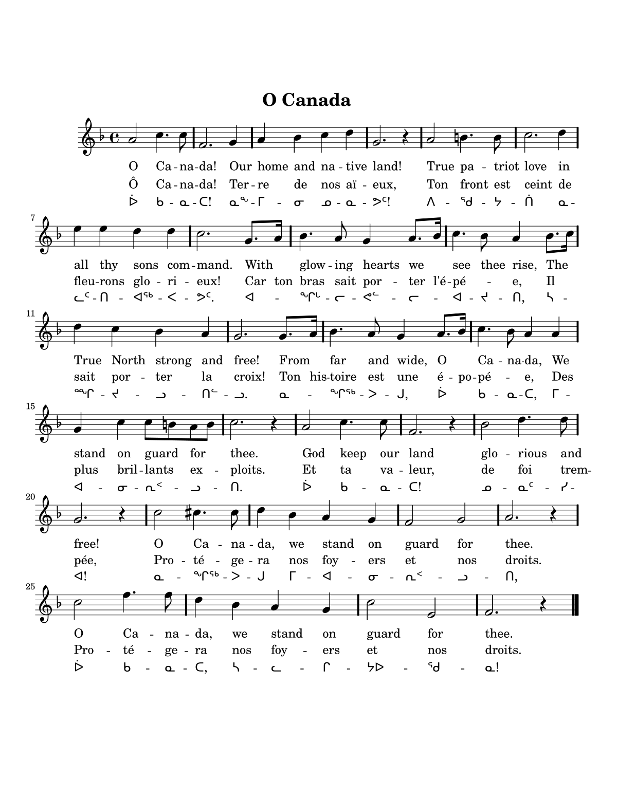

Slide 31
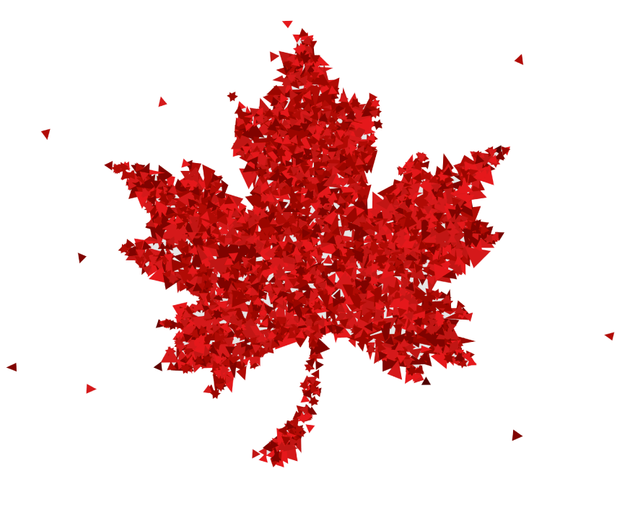
Symboles of Canada
There are many symbols of Canada, including the beaver, maple leaf, moose, loon, and many more.

Slide 32
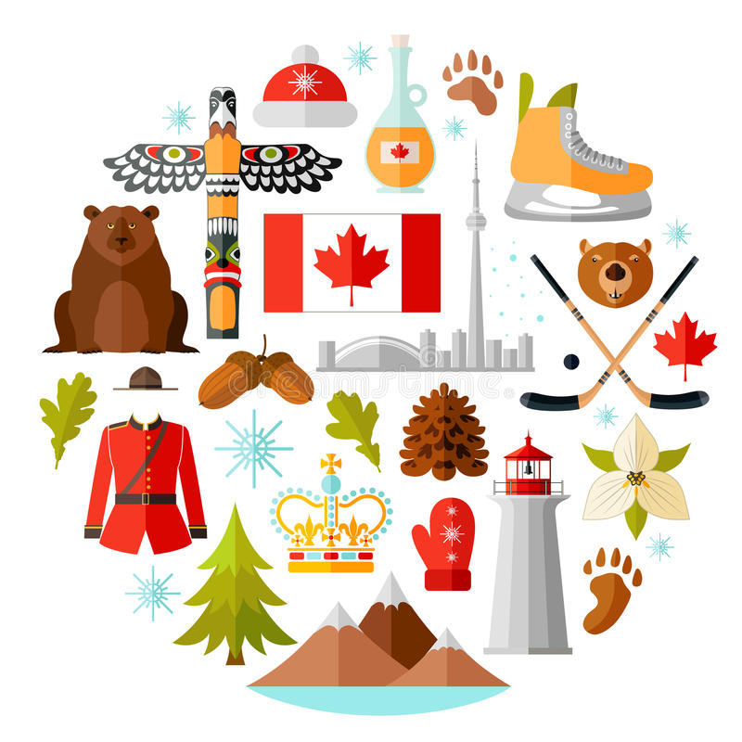

Slide 33
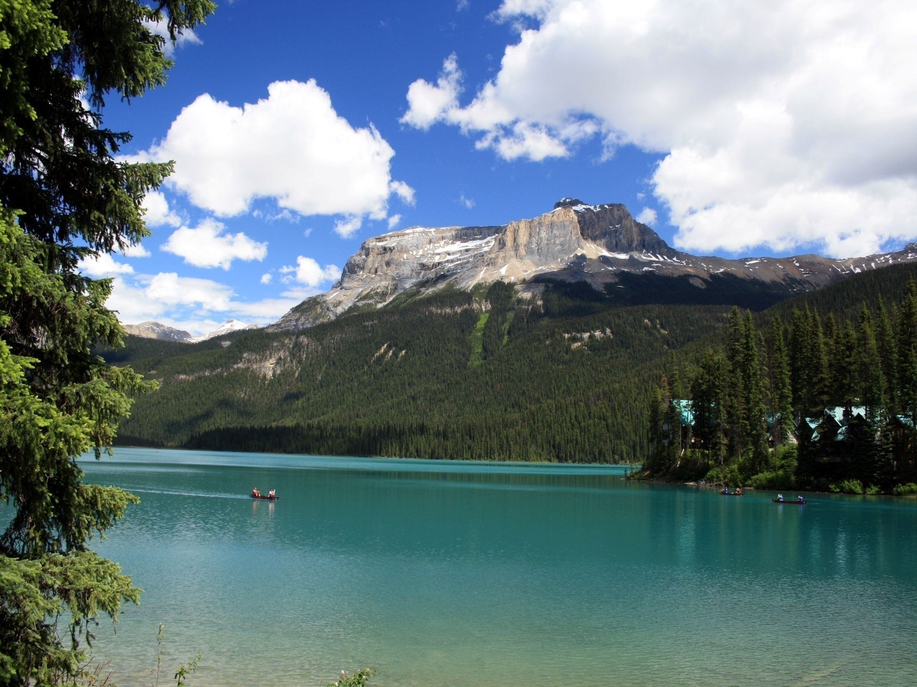
Most Beautiful National Parks in Canada
Yoho National Park
Just two hours from the bustling city of Calgary, the Yoho National Park is an amazing getaway spot for nature lovers. Emerald Lake looks unreal thanks to its bright, vibrant colors, and Lake O’Hara is just as picturesque. Other top attractions you won’t want to miss include the Natural Bridge, Takakkaw Falls and Wapta Falls.

Slide 34
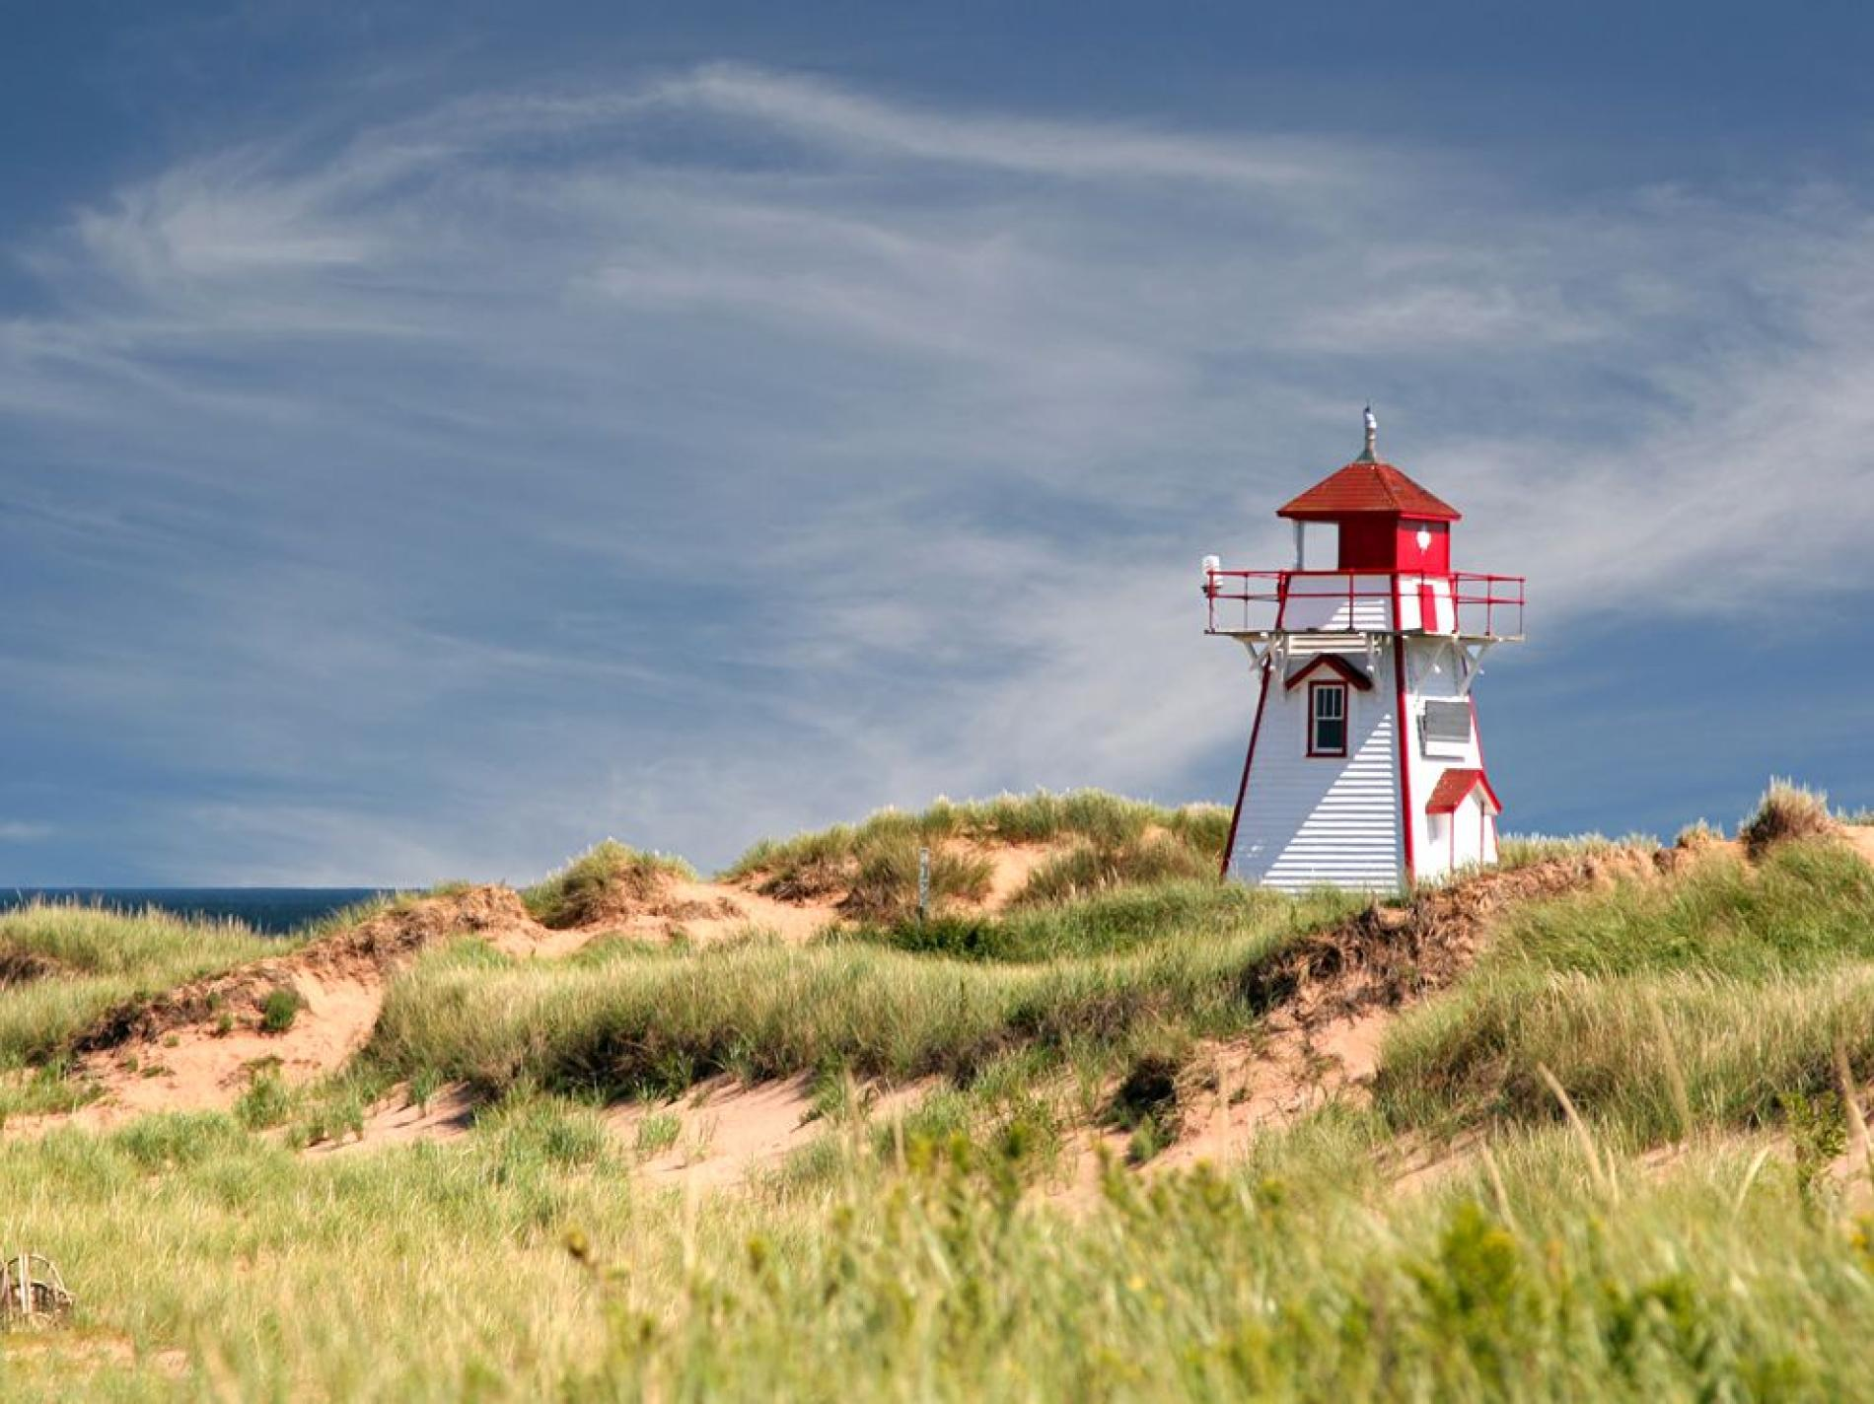
Prince Edward Island National Park
Prince Edward Island National Park is located on Prince Edward Island, the only island province with a location in the Atlantic Ocean. Located on the North Shore of the island, Prince Edward Island National Park boasts red sandstone cliffs that drop right into the water, creating stunning vantage points along miles of coastal trails.

Slide 35
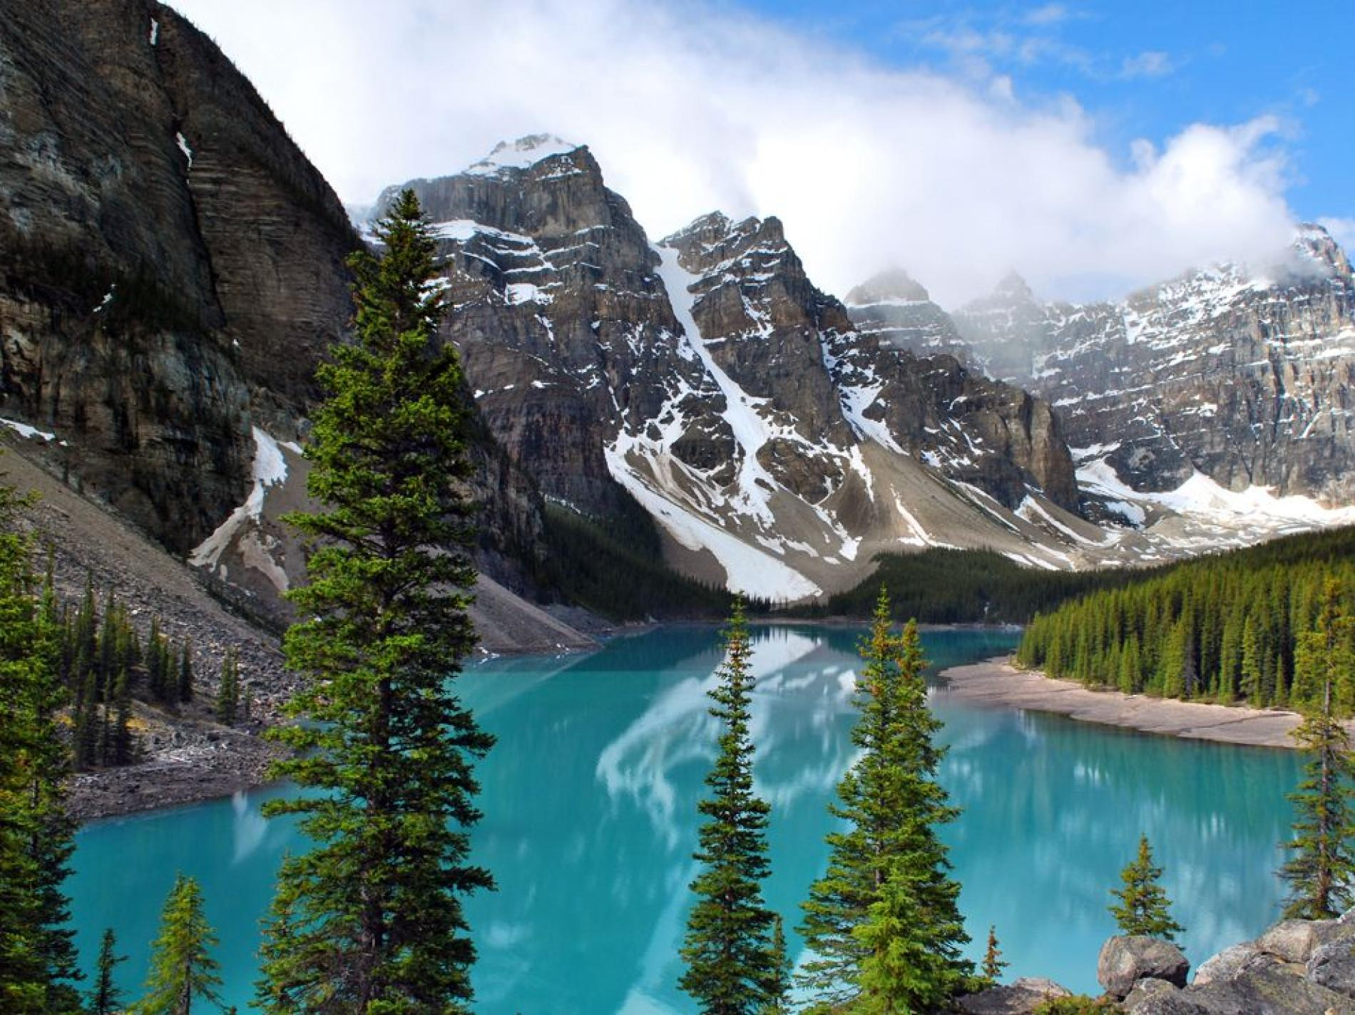
Banff National Park
Perhaps the best known of the national parks in Canada is Banff National Park, which is located in the Alberta Rockies. Lake Louise is a stunning body of water with scenic views, and the gondolas in the park can provide even more spectacular aerial vistas.

Slide 36
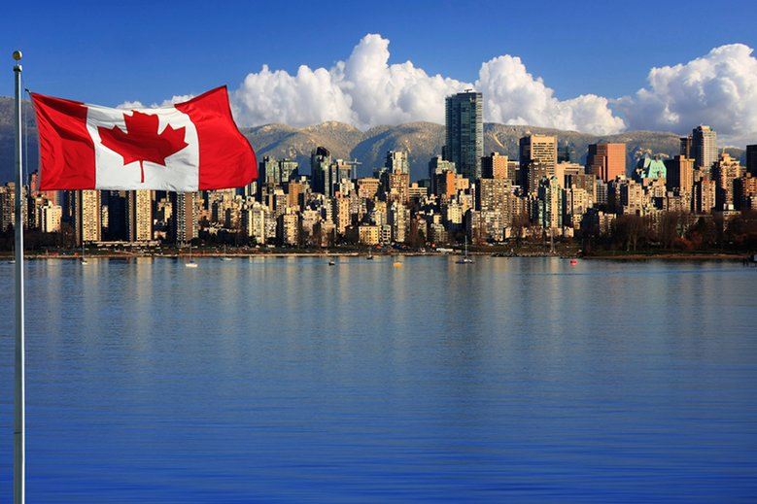
Emilia Cięciwa
3b

