Slide 1
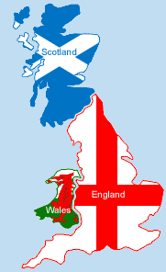
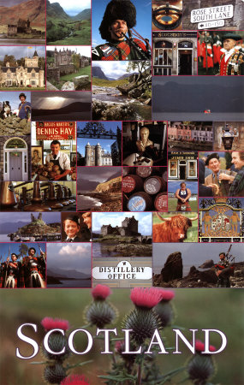
SCOTLAND

Slide 2
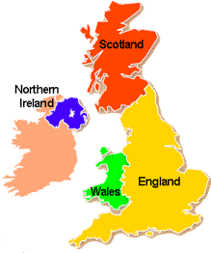
Where is Scotland?
Scotland is in north-west Europe and is a part of Great Britain and the United Kingdom, which includes England, Wales, Scotland and Northern Ireland.

Slide 3

The National Flag of Scotland: ‘Cross of St Andrew’

Slide 4
Population
Scottish Population -
around 5.2 million
Population of Scotland's main cities:
Glasgow - 592,820
Edinburgh - 486,120
Aberdeen - 217,120
Dundee - 144,290

Slide 5
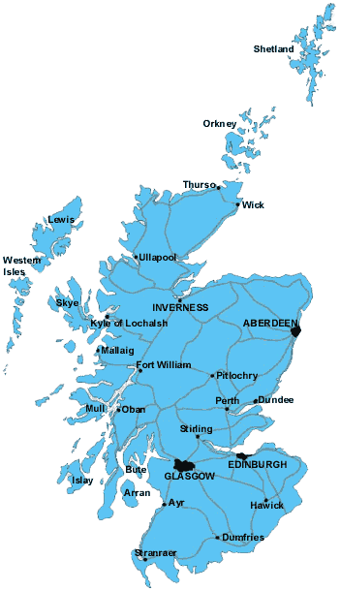

Slide 6
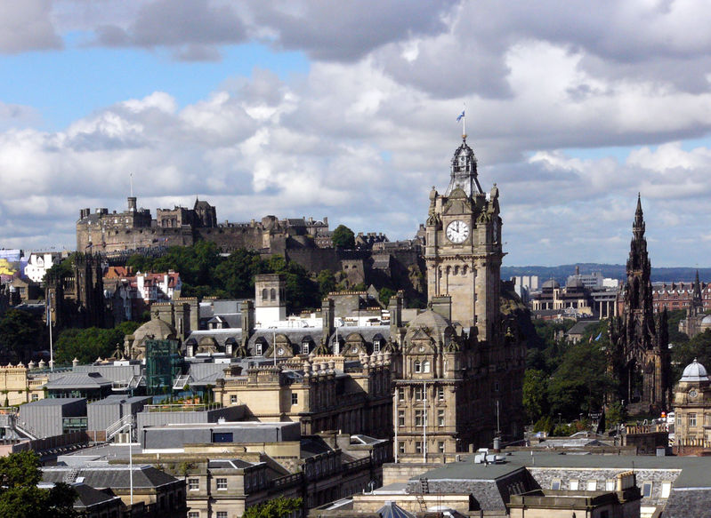
Capital city - EDINBURGH

Slide 7
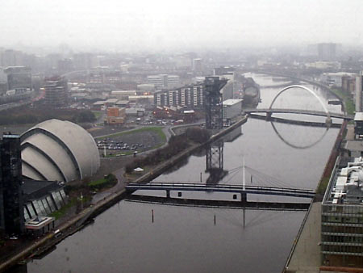
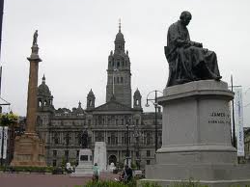
Glasgow – the largest city in Scotland

Slide 8
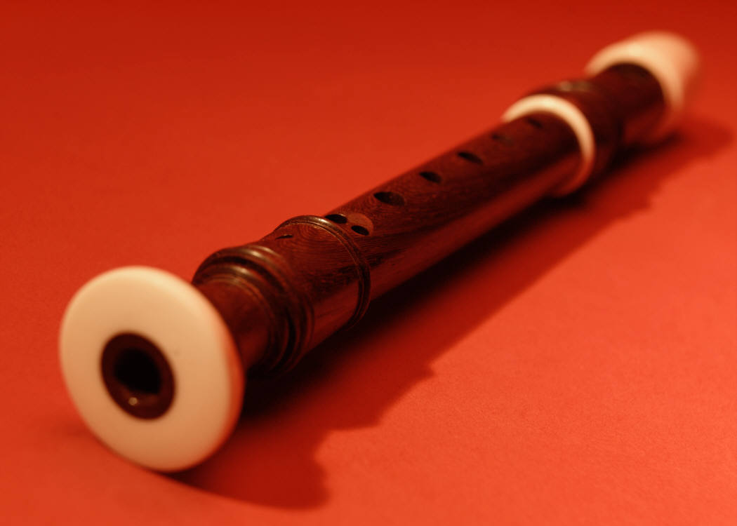
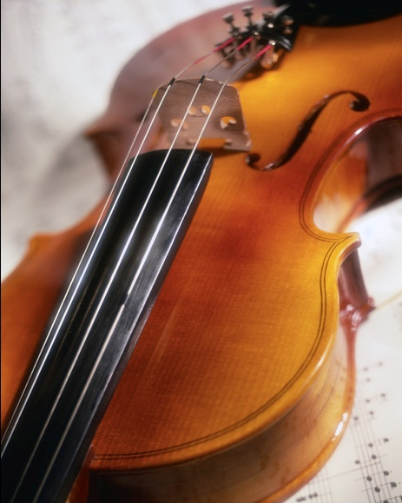
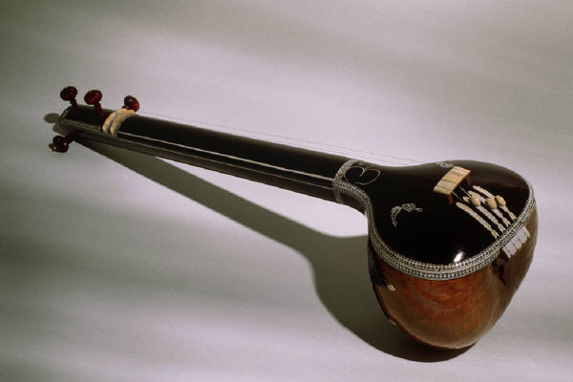
MUSIC
Fiddle
Flute
Bagpipes - the Scottish Highland pipes are the loudest, played standing, usually in pipe bands.
Mandolins, guitars
Harp

Slide 9
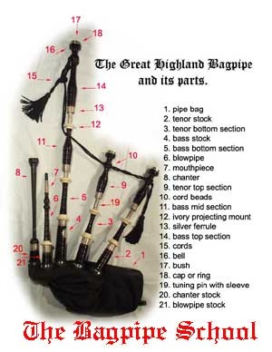
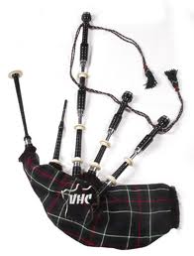
BAGPIPE

Slide 10
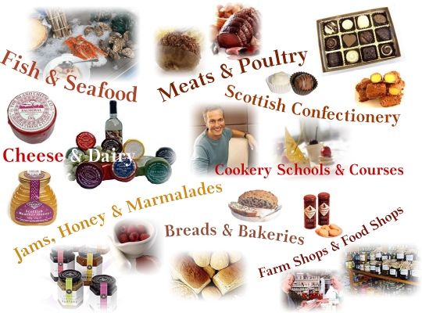
Scottish Food

Slide 11
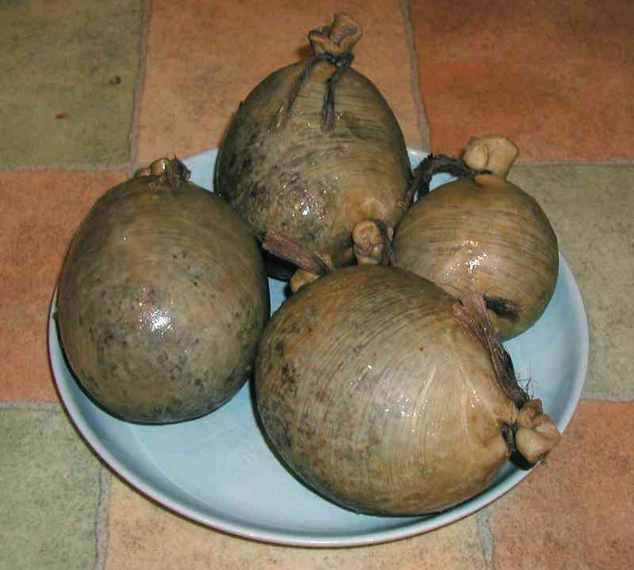
Haggis

Slide 12
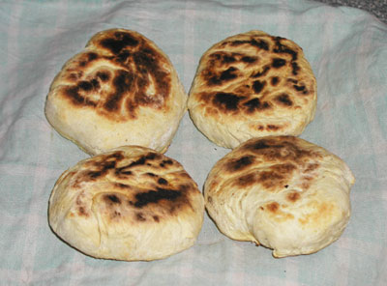
Bannocks

Slide 13
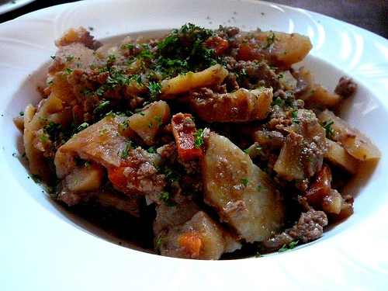
Stovies

Slide 14
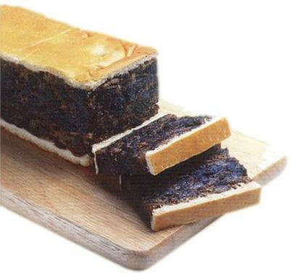
Black Bun

Slide 15
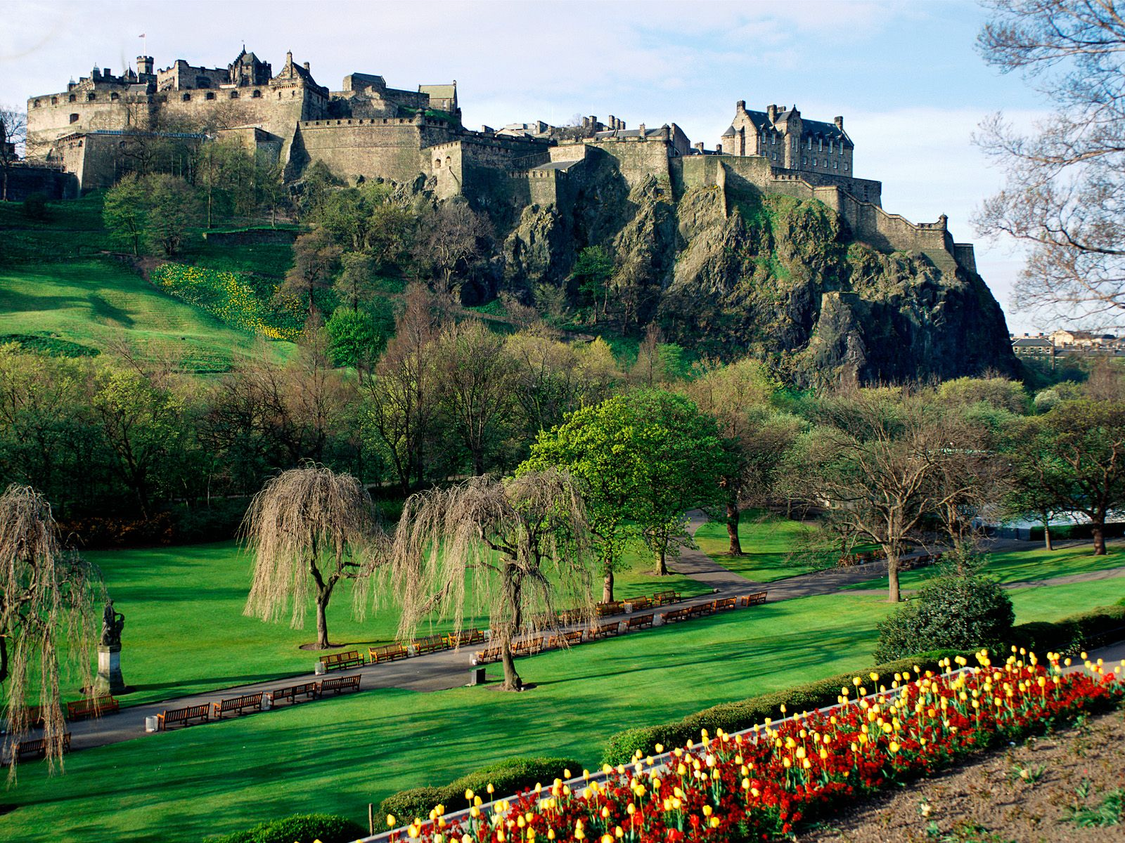
Edinburgh castle

Slide 16
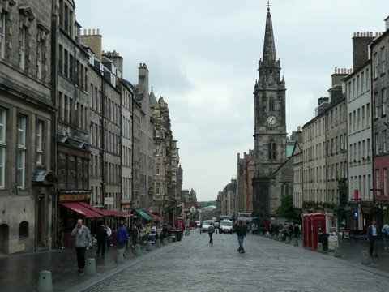
Royal Mile

Slide 17
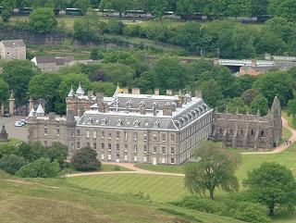
Palace of Holyroodhouse – the Queen's official residence in Scotland.

Slide 18
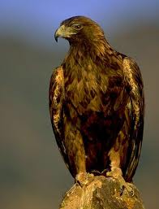
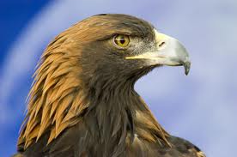
GOLDEN EAGLE – the national icon

Slide 19
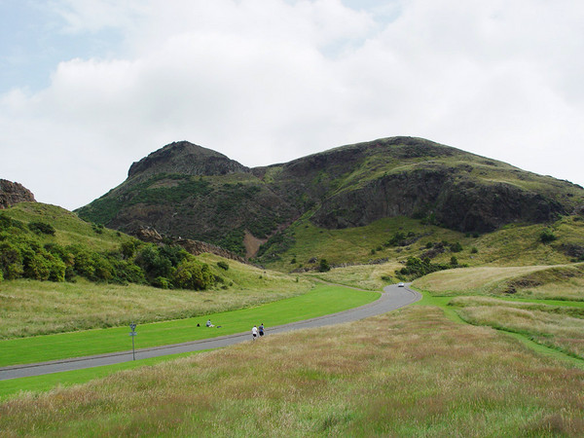
Holyrood Park

Slide 20
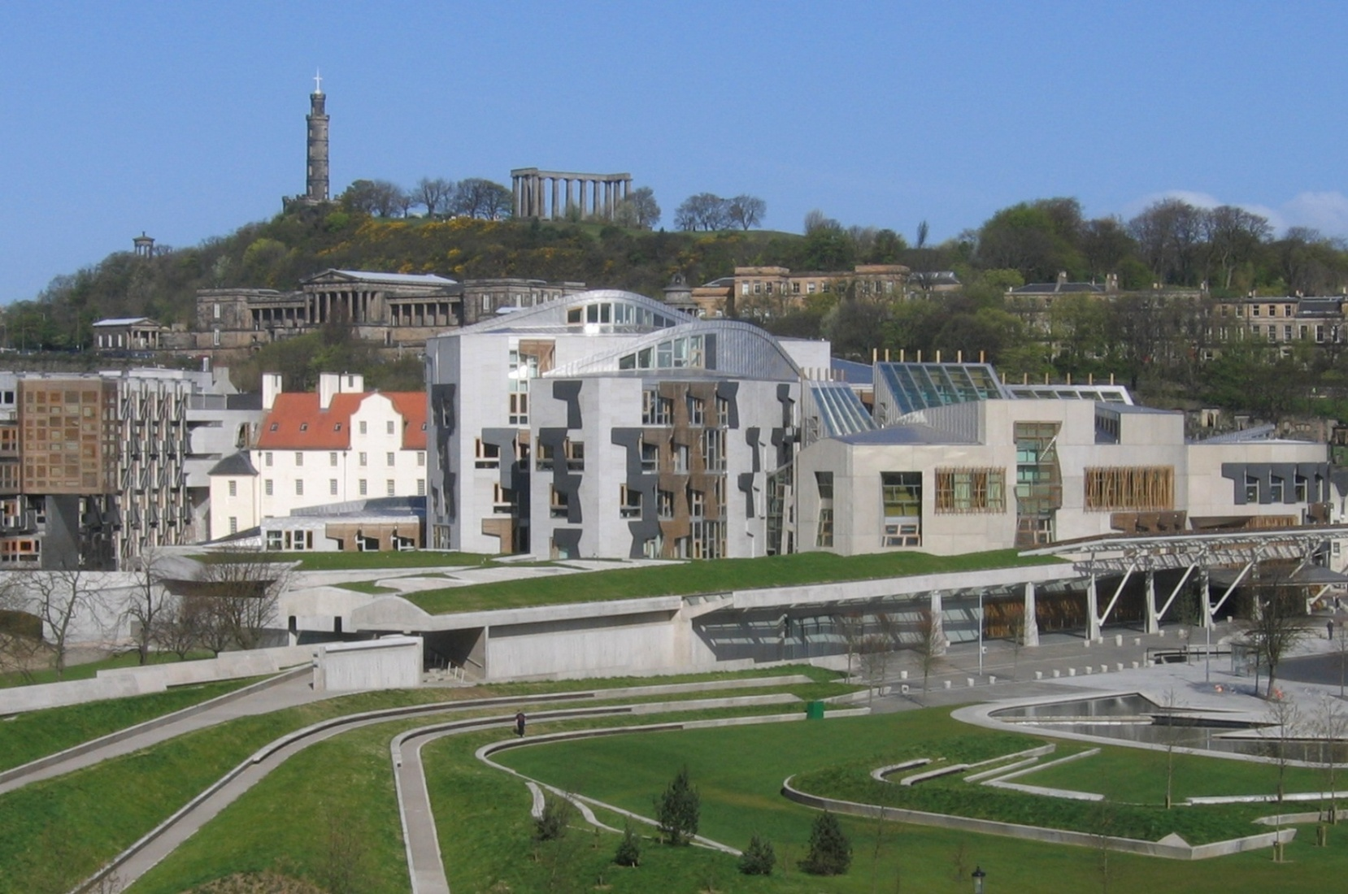
Scottish Parliament in Edinburgh

Slide 21
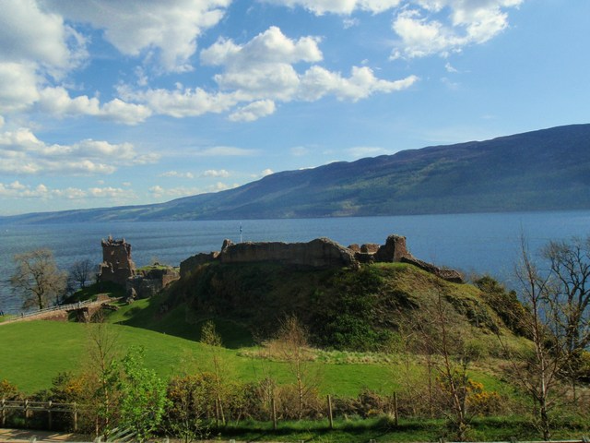
Loch Ness

Slide 22
National Anthem of Scotland
1. O Flower of Scotland,
When will we see
Your like again,
That fought and died for,
Your wee bit Hill and Glen,
And stood against him,
Proud Edward's Army,
And sent him homeward,
To think again.
2. The Hills are bare now,
And Autumn leaves
lie thick and still,
O'er land that is lost now,
Which those so dearly held,
That stood against him,
Proud Edward's Army,
And sent him homeward,
To think again.
3. Those days are past now,
And in the past
they must remain,
But we can still rise now,
And be the nation again,
That stood against him,
Proud Edward's Army,
And sent him homeward,
To think again.
O Flower of Scotland,
When will we see
your like again,
That fought and died for,
Your wee bit Hill and Glen,
And stood against him,
Proud Edward's Army,
And sent him homeward,
To think again.

Slide 23
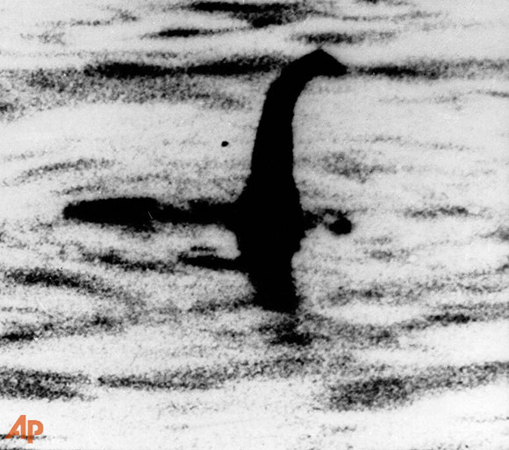
Loch Ness Monster
It is a typical Scottish legend
People described it as big creature with very long tail and a long neck
Scottish people called monster – ‘NESSIE’
Scientists say that the monster doesn’t exist

Slide 24
Symbols of Scotland
the Thistle and Scottish Bluebell
The national flower of Scotland is the thistle, a prickly-leaved purple flower which was first used in the 15th century as a symbol of defence. The Scottish Bluebell is also seen as the flower of Scotland.

Slide 25
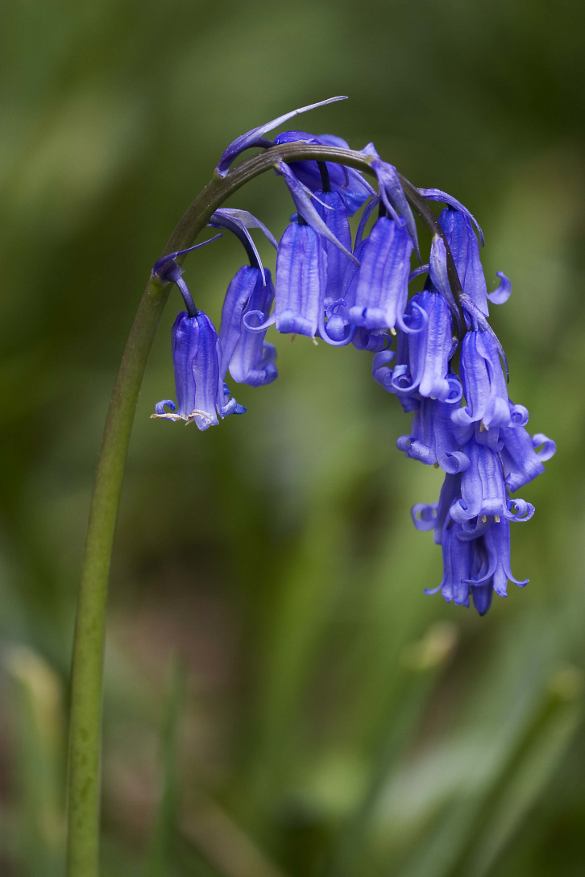
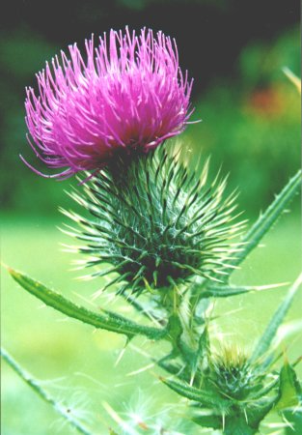
THISTLE & BLUEBELL

Slide 26
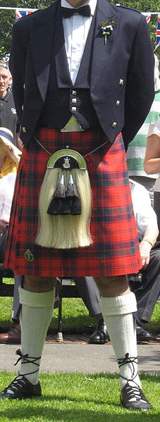
What is the national dress of Scotland?
In Scotland the national dress is a kilt.
the traditional dress of men and boys in the Scottish Highlands of the 16th century
The kilt is worn around the waist.

Slide 27
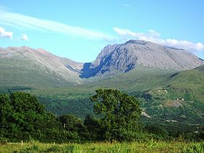
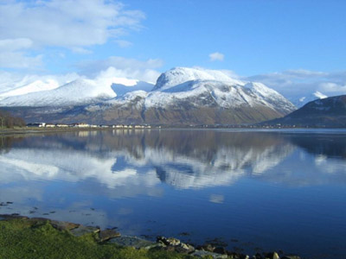
BEN NEVIS
The highest mountain in the British Isles (1,344 m)

Slide 28
FAMOUS PEOPLE
Famous Scots include: Walter Scott, Robert Louis Stevenson, Arthur Conan Doyle and the actor Sean Connery.
Famous musicians of Scotland include Annie Lennox, Wet Wet Wet, Travis and Simple Minds.

Slide 29
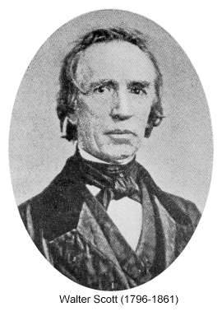
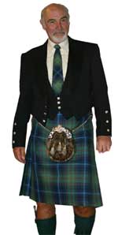
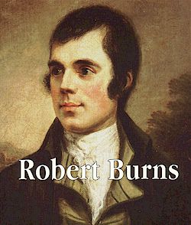
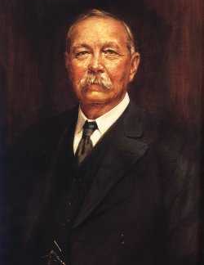
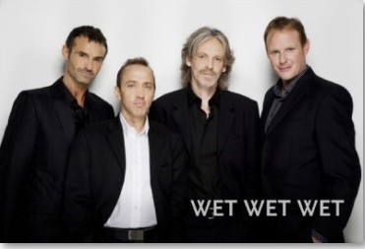

Slide 30
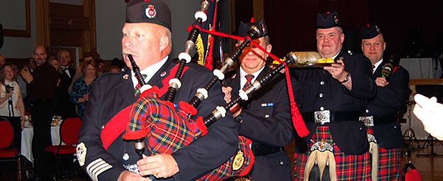
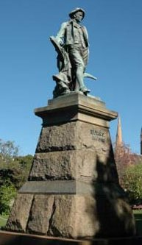
Burns' Night
The birthday of Scotland's most famous poet, Robert Burns (1759-1796), celebrated with great festivity by the Scots. This festival often include the bagpipes, Scotsmen in kilts,reading of Burns' poem and the dish - haggis.

Slide 31
Sport in Scotland
Golf - there are over 400 golf courses in Scotland alone.
Polo
Rugby
Cricket
Football (soccer)

Slide 32
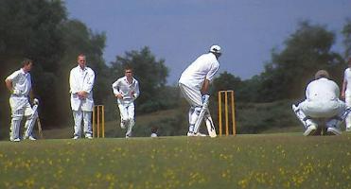
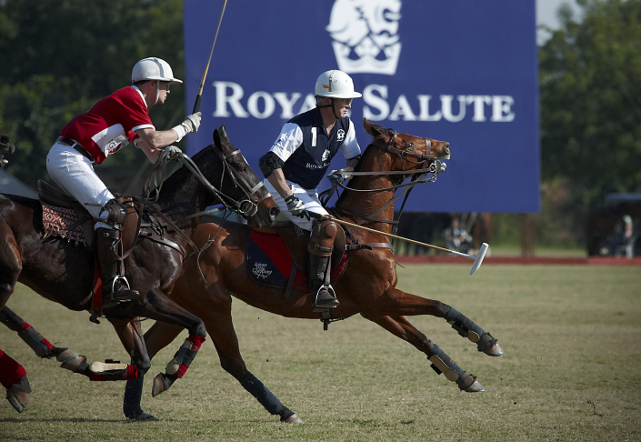
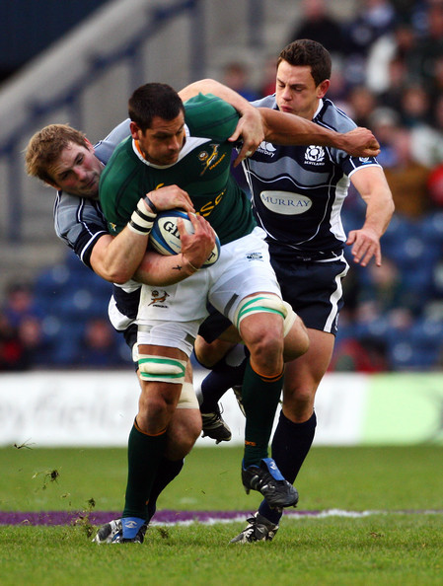
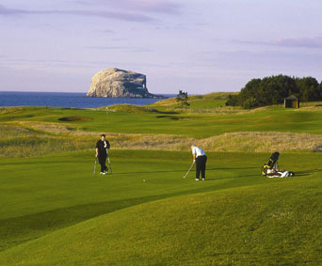

Slide 33
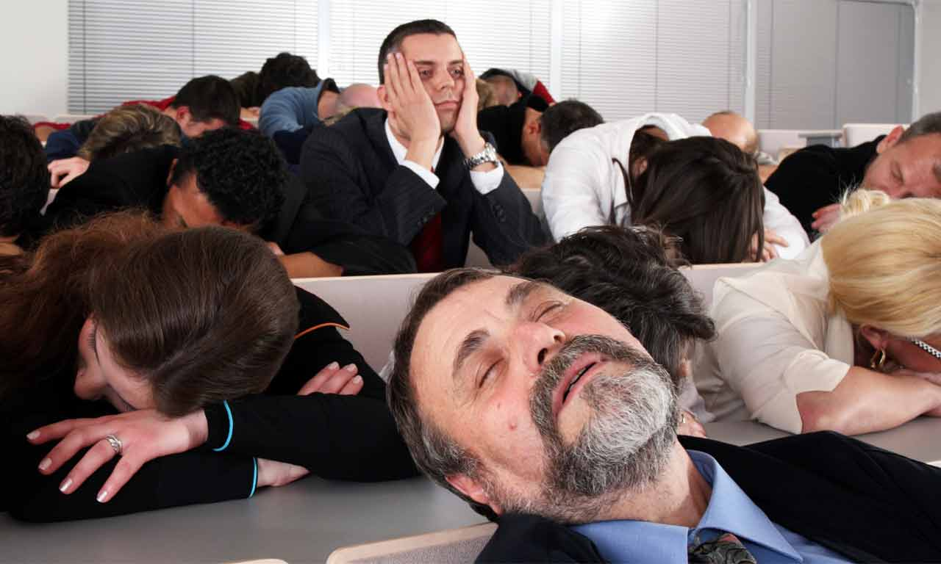
THE END
THANK YOU
Thank you for your attention

