Slide 1
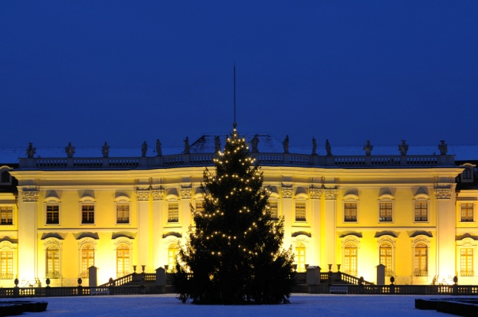
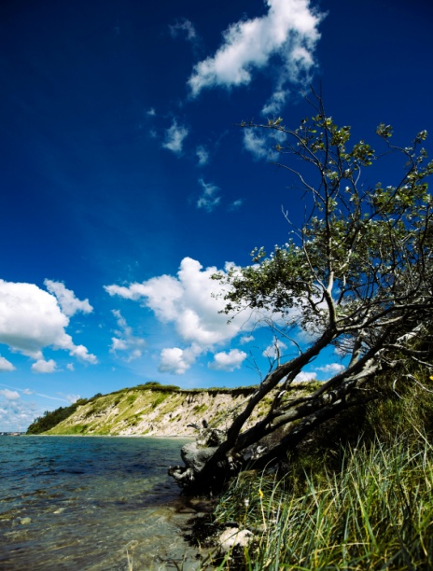
Germany
“But the same intelligence compels Germany to practice the same policy.” –Pierre Laval

Slide 2
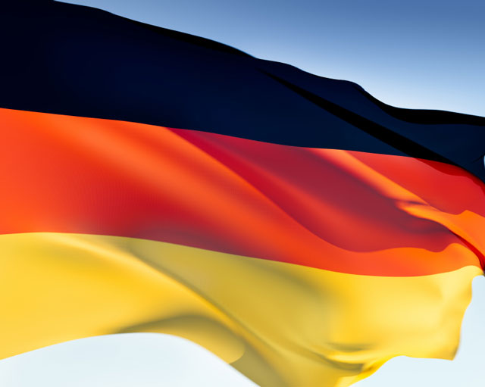
The Flag
Black: Determination
Red: Hardness, bravery, valor, strength
Yellow (gold): Generosity

Slide 3
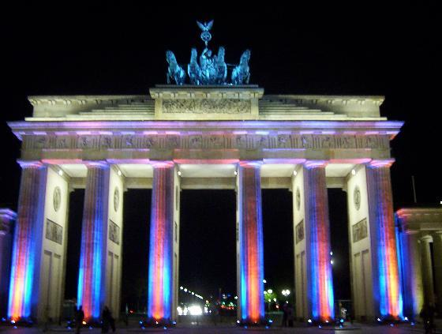
Brandenburg Gate
This gate is one of Berlin’s famous land marks.
Built in 1789 and completed in 1791 by Carl Langhans.
Its official opening was on August 6, 1791.
The gate was infamous during the Cold War because it was a symbol of Berlin and the rest of Germany dividing.
In 1989 when the Cold War was over the Brandenburg Gate became famous again.

Slide 4
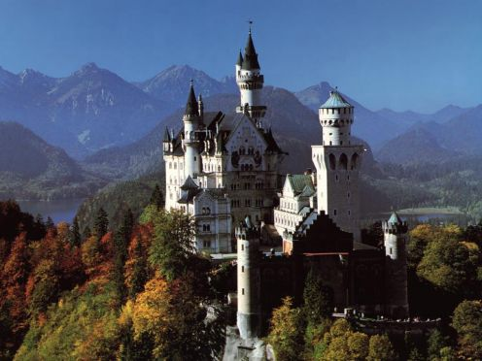
The Neuschwastein Castle
Built in the Bavarian Alps by Ludwig II.
It was used as a defense castle but was originally made as a fairy tale castle that Ludwig II had designed in 1869.
Even though it was built in the 1800’s, the castle has modern day appliances in it. Such as heat, hot water, and even flushing toilets.

Slide 5
Munich (Oktoberfest)
The capital of Bavaria and the gateway to the Bavarian Alps
Oktoberfest is the highlight of everyone’s German calendar.
The festival is famous for its beer
Over 6 million people per year come to experience the culture of Oktoberfest.
Traditional costumes are worn by the Oompha Bavarian band music preformers.

Slide 6
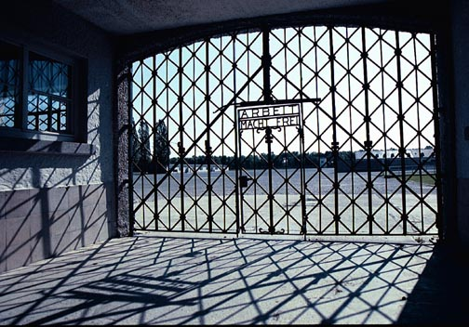
Dachau
Dachau is a concentration camp located in Munich.
Created in 1933. It was used as a training camp for the staff that were later going to work at other concentration camps like Auschwitz.
Closed in 1945
It’s now a memorial for all the people that died there during the Holocaust.

Slide 7
Romantic Road
A scenic road going through Germany, beginning at Franconia and ending at the Neuschwanstein castle.
261 miles long.
During the Middle Ages the road was used as a major trade route.
The road passes along small towns, towers, and medieval castles lining the road.

Slide 8
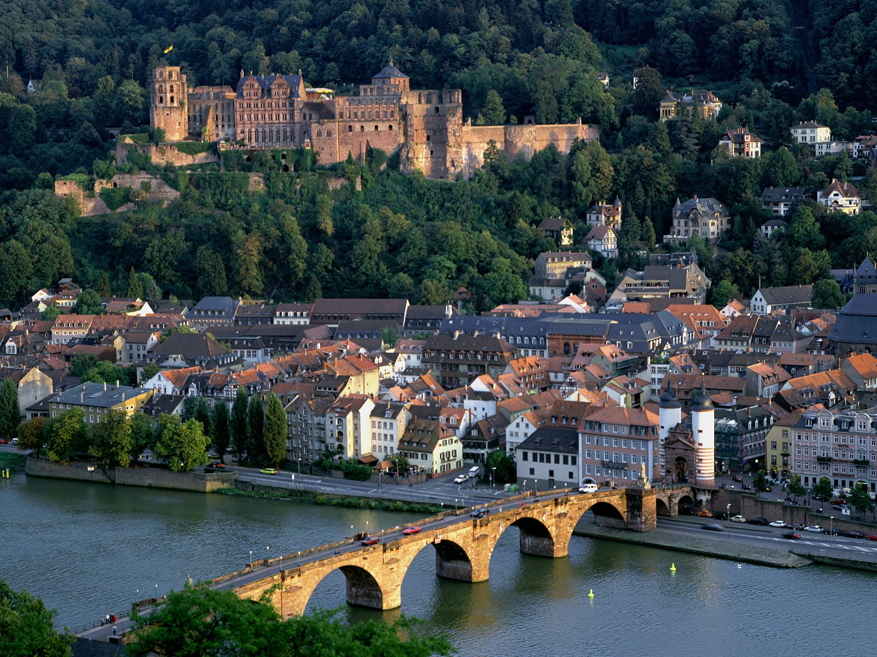
Heidelberg
A scenic town with a large population.
A U.S navel base is stationed there.
It was one of the only cities that didn’t get destroyed during WW II.
People come from all over the world to see the remains from the Heidelberg castle and the Idyllic river.
The towns cobble stone roads are only an hour away from Fankfurt, Germany.

Slide 9
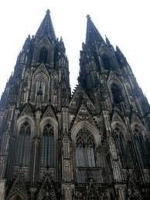
Cathedral of Cologne
This is the third largest cathedral in the world.
It is a gothic cathedral that took over 600 years to build (1248 to 1880.
The cathedral is one of the only other buildings that survived the bombings of WWII.

Slide 10
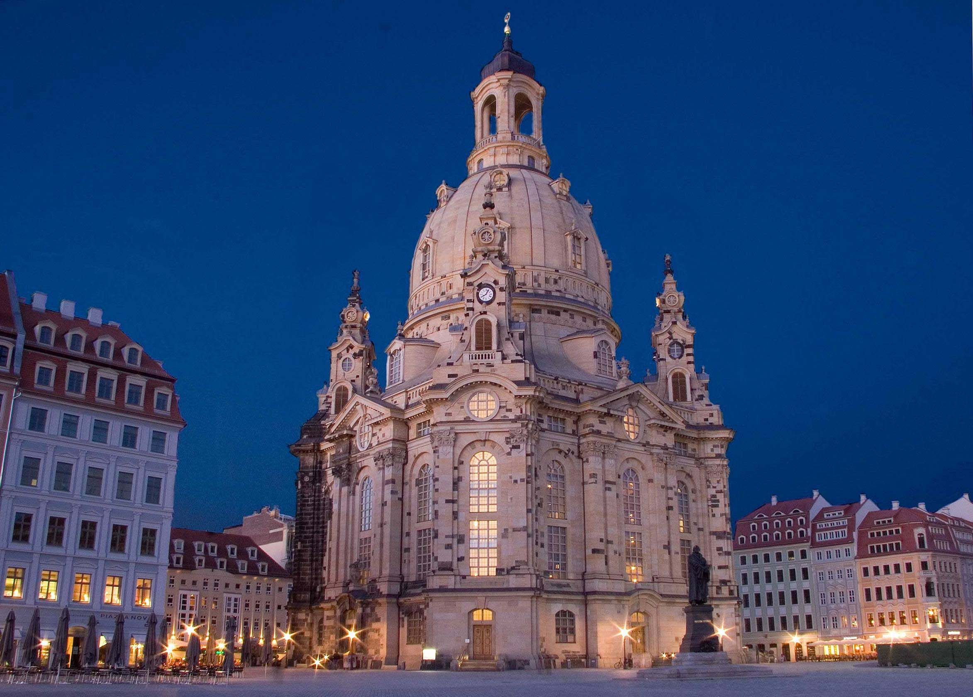
The Dresden Frauenkirche- Church of Our Lady
The church collapsed in WWII into just a pile of remains when air raids destroyed the city.
It wasn’t rebuilt until 40 years later to remind people of the destructive war.
In 1980 the church was a sight for peaceful protesting the East German Government
In 1994 the church was rebuilt with money from private donations and was completed in 2005.

Slide 11
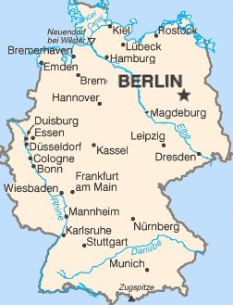
Germany- The Capital

Slide 12
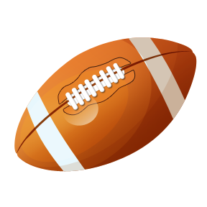
Top 6 Sports
1) Football
2) Ice Hockey
3) Rugby
4) Bobsled
5) Luge
6) Cycling

Slide 13
Food
Tafelspitz- braised beef with horseradish
Rosti- potato pancakes fried with a combonation of onion and butter
Schwarzwalder- A black forest cake made of whipped cream, grated chocolate, and cherries.
Himmel und Erde (Heaven and Earth)- apple and potatoes topped with sausage.

Slide 14
Ethnic Groups
Most of Germany is made up of it’s own people
German’s: 91.5%
Turkish: 2.4%
Other (Spanish, Serbo-Croatian, Russian, Polish, Greek, Italian): 6.1%

Slide 15
Bibliography
<http://www.flags-flags-flags.org.uk/german-flag.htm>.
<http://www.indexmundi.com/germany/ethnic_groups.html>.
<http://www.globalgourmet.com/destinations/germany/germmenu.html#axzz1FG662svv>.
<http://www.brainyquote.com/quotes/keywords/germany.html>.
Http://www.letstravelradio.com/thisweek/2009/01-08/berlin-map.jpg."
<http://en.wikipedia.org/wiki/Sport_in_Germany>.

