Slide 1
Social life - revision

Slide 2
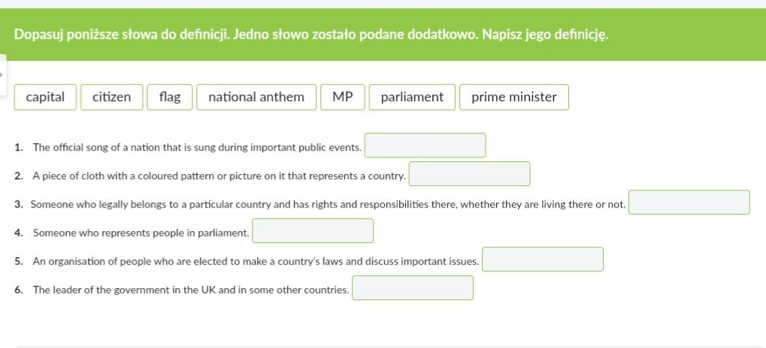
Ex. 1

Slide 3
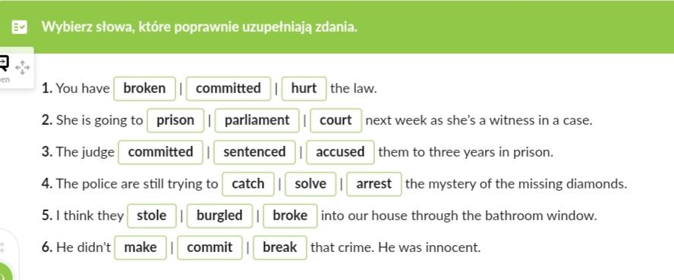
Ex. 2

Slide 4
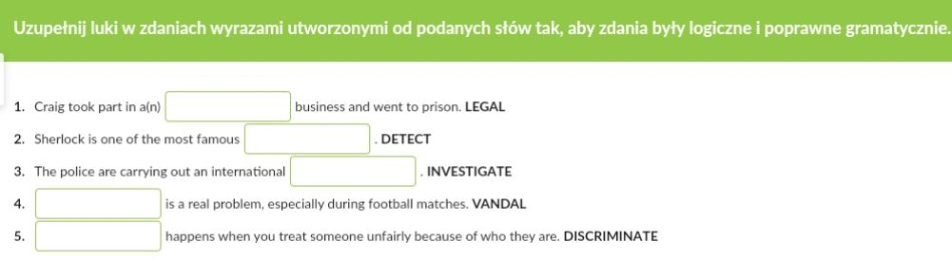
Ex. 3

Slide 5
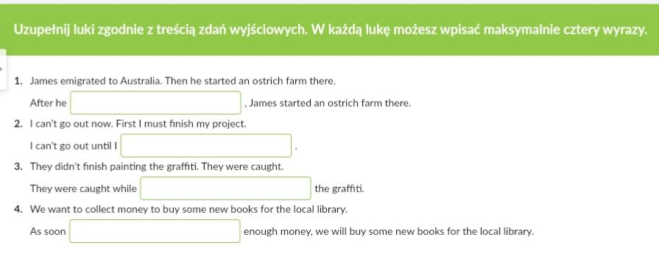
Ex. 4

Slide 6
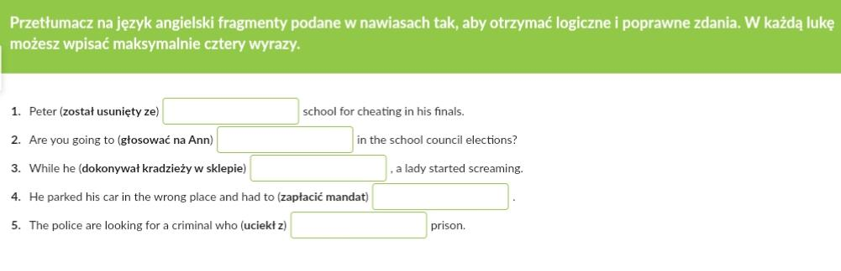
Ex. 5

Slide 7
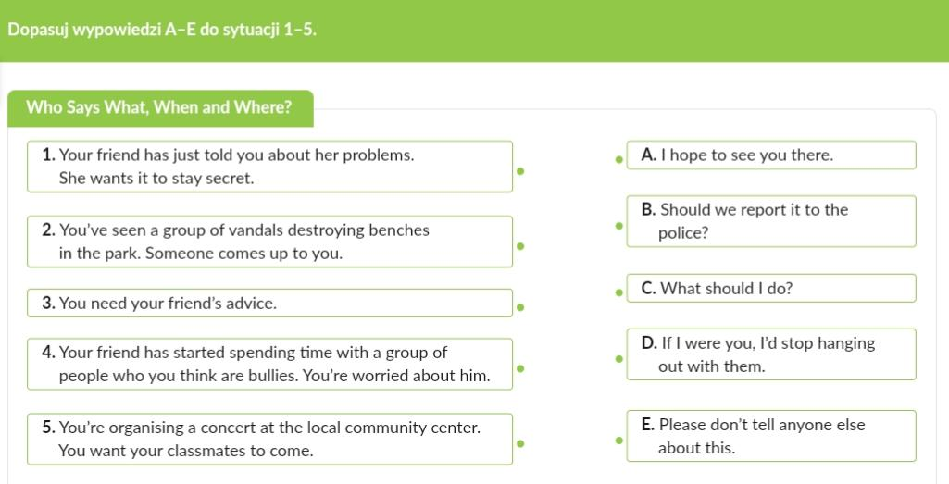
Ex. 6

