Slide 1
Social life - revision

Slide 2
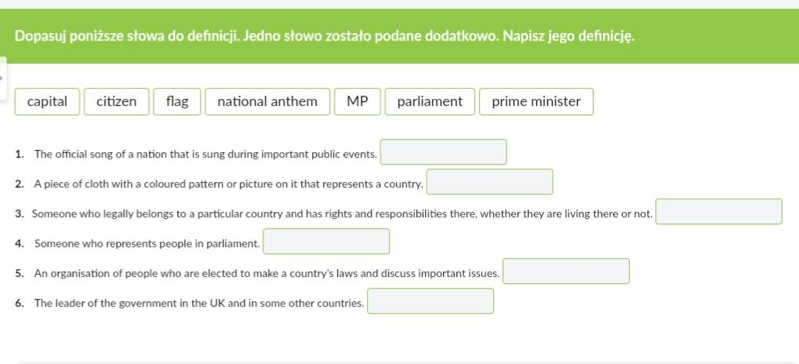
Ex. 1

Slide 3
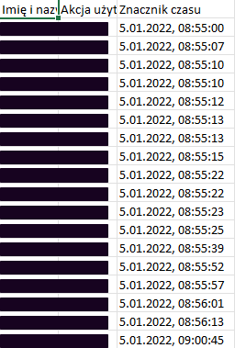

Slide 4


