Slide 1
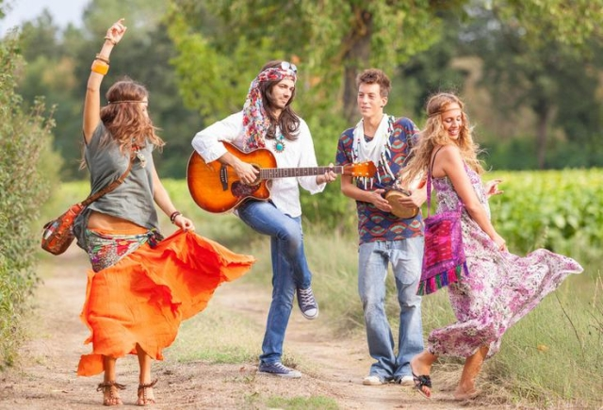


Hippie movement

Slide 2
The hippie subculture was originally a youth movement that began in the United States (San Francisco) in the middle 1960s as a reaction against the Vietnam war and spread around the world
The word hippie came from hipster (used to describe people who had moved into New York City's Greenwich Village and San Francisco's Haight-Ashbury district)

Slide 3

Hippies were young people, about 25 years old, mostly from rich families, who rejected their way of life and matherialistic system of values
They left comfort, elegance, shallow adult way of life and they chose simple and natural life
They want to fight with: national, race, religious and other diferences

Slide 4
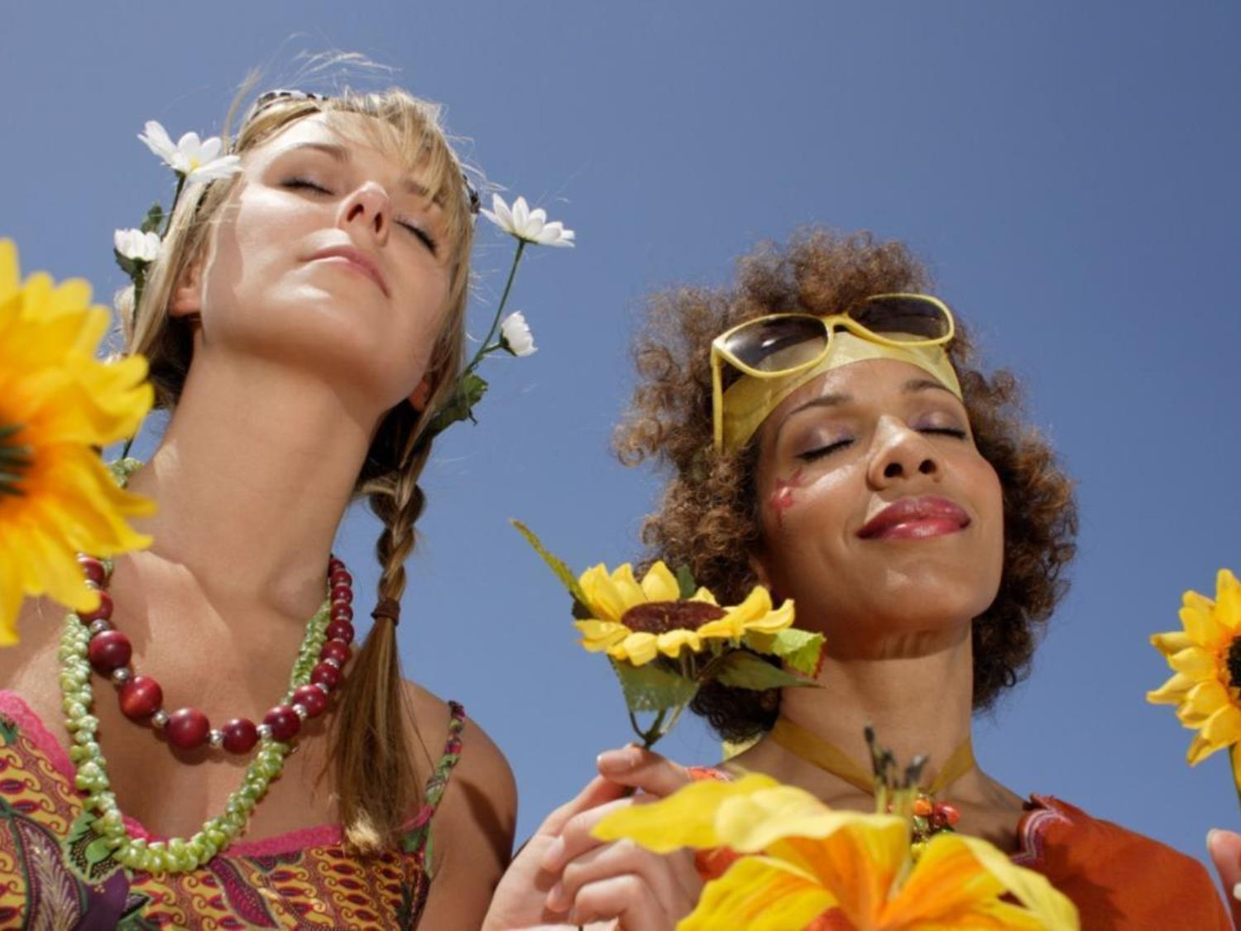
„Hate and war will let place to peace and love. All divisions will dissapear in brotherhood and music
will be heard everywhere.“

Slide 5
Hippies:
Vegetarians
Nudists
Used natural medicine
Wanted a clothing reform
Wanted economic, social, cultural and religious reforms
Were for freedom for children, women and animals

Slide 6
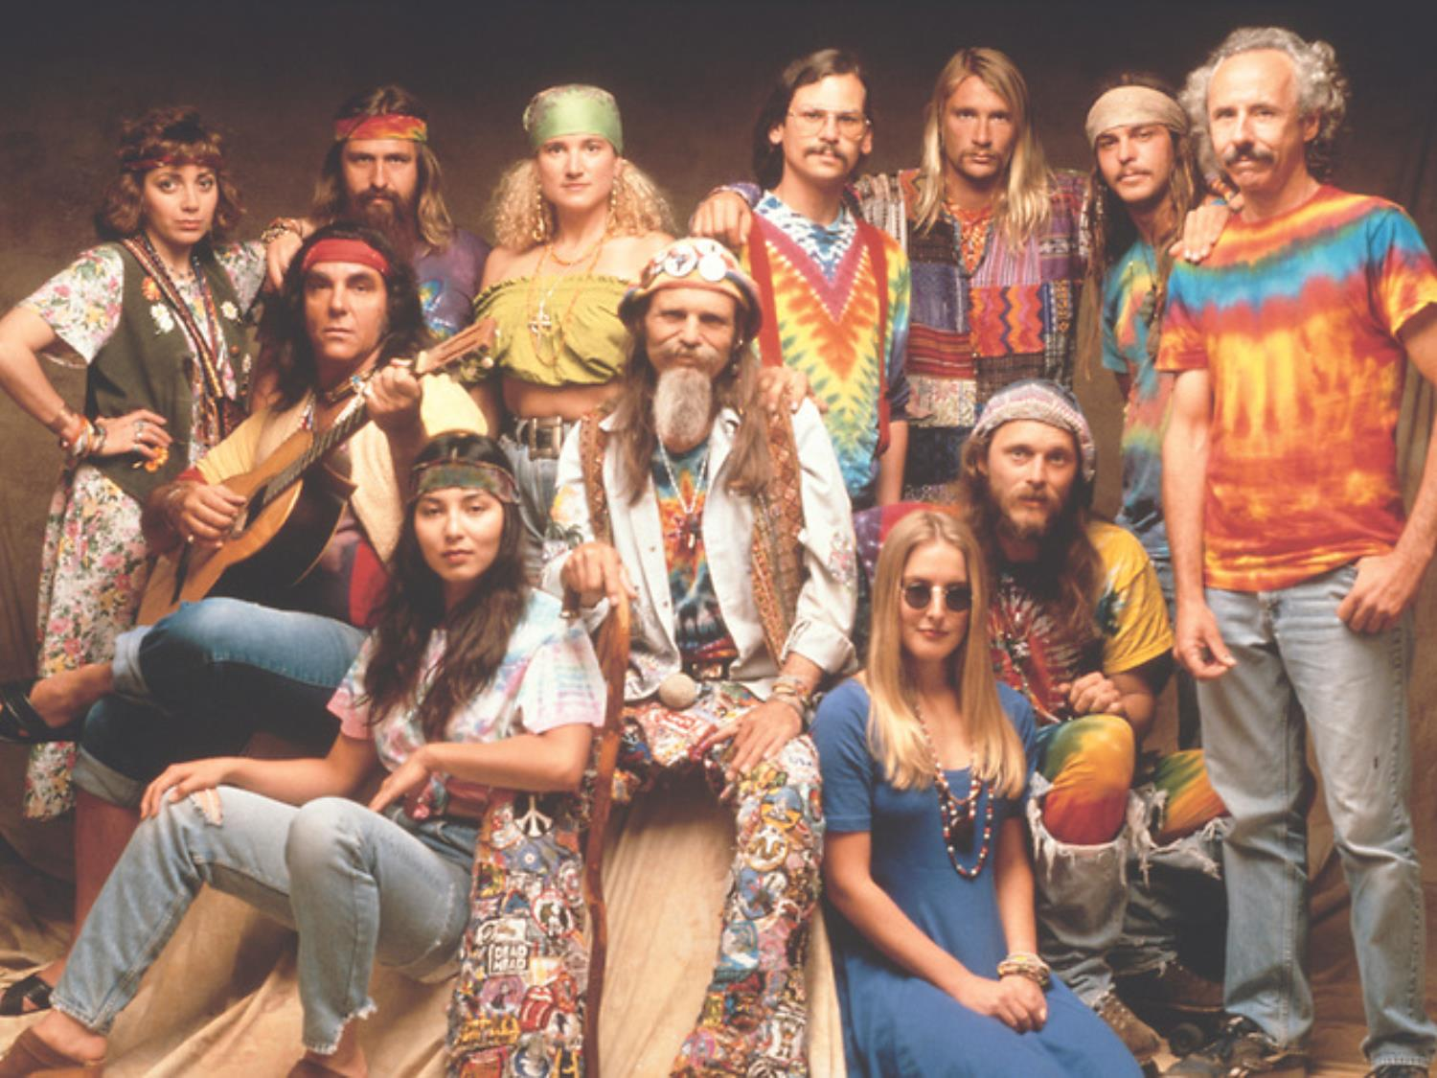

Slide 7
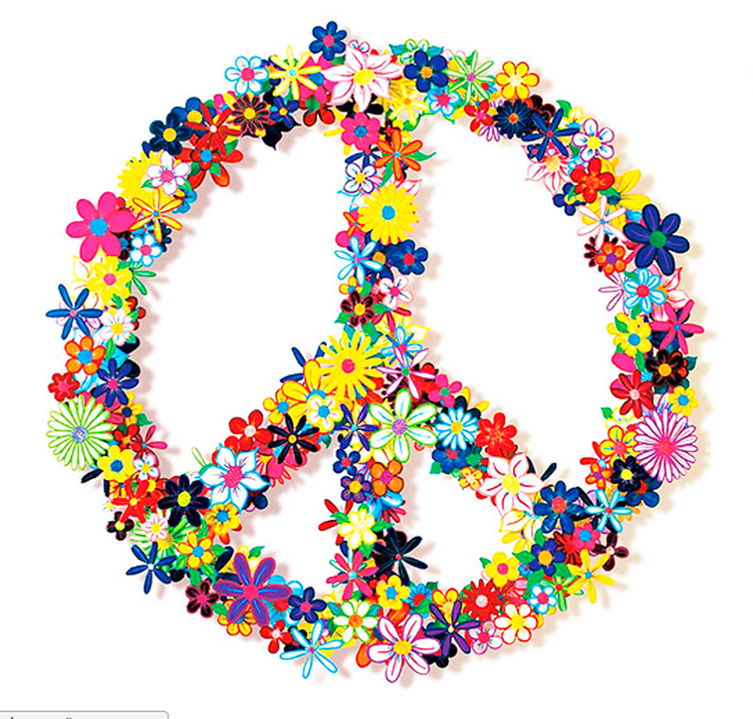
Flower Power
They were promoting „Flower Power“ philosophy against war and hate so they were called „Flower children“

Slide 8
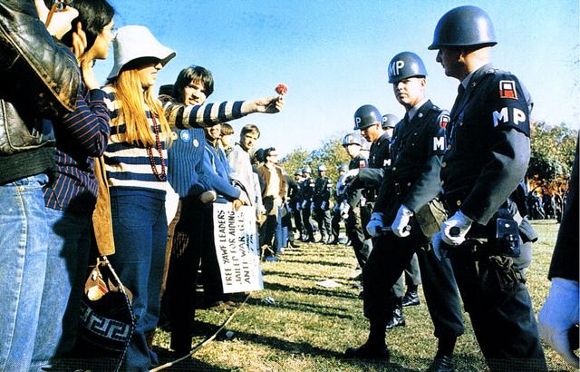
Flower Power included actions such as giving flowers to the policeman or putting flowers in guns as a sign of peace not war

Slide 9
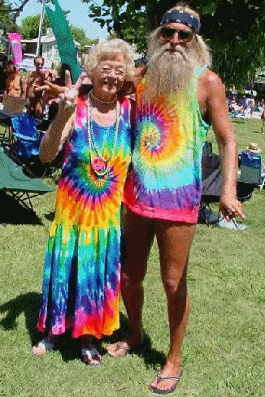
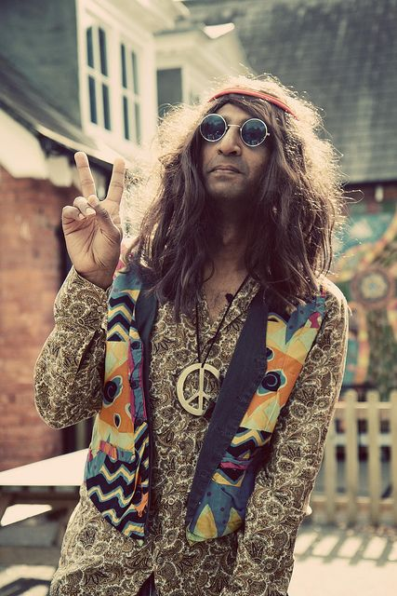
The look

Slide 10
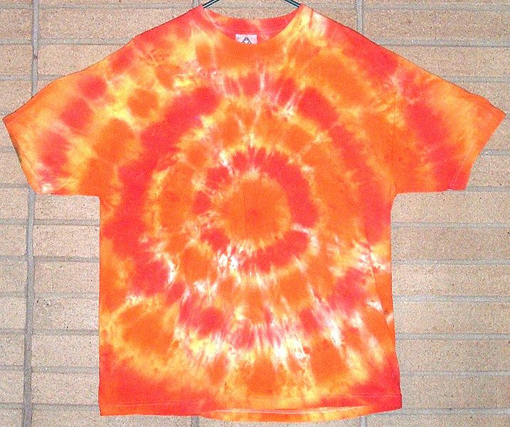
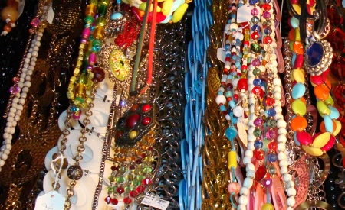
They were wearing jeans and colorful pants, large
T-shirts and skirts
The long hair was a symbol of protest, freedom, individuality, pride. Hair and neck were decorated with flowers
The jewellery with peace symbols was made of colorful pearls

Slide 11
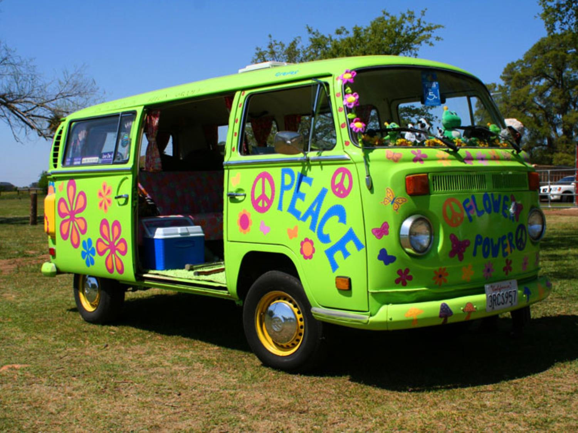
Hippie Bus

Slide 12
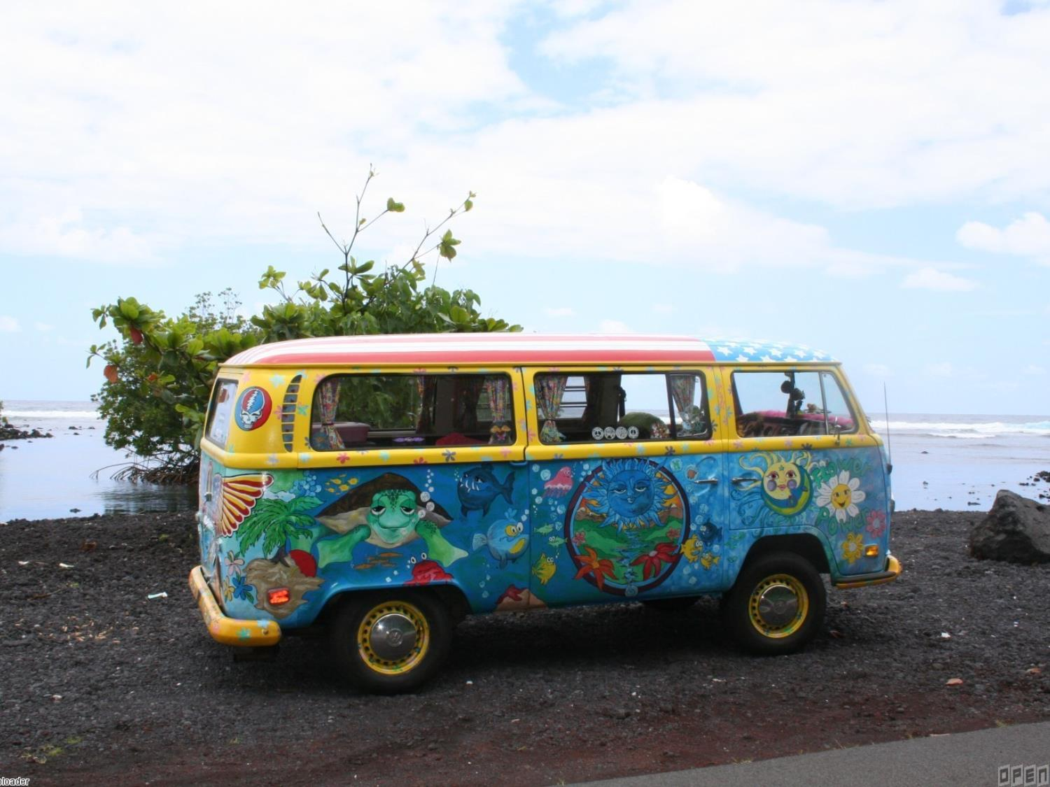
The VW Bus became known as a hippie symbol, and many buses were repainted with graphics connected with hippies
Many hippies did not have any cars so they preferred hitchhiking

Slide 13
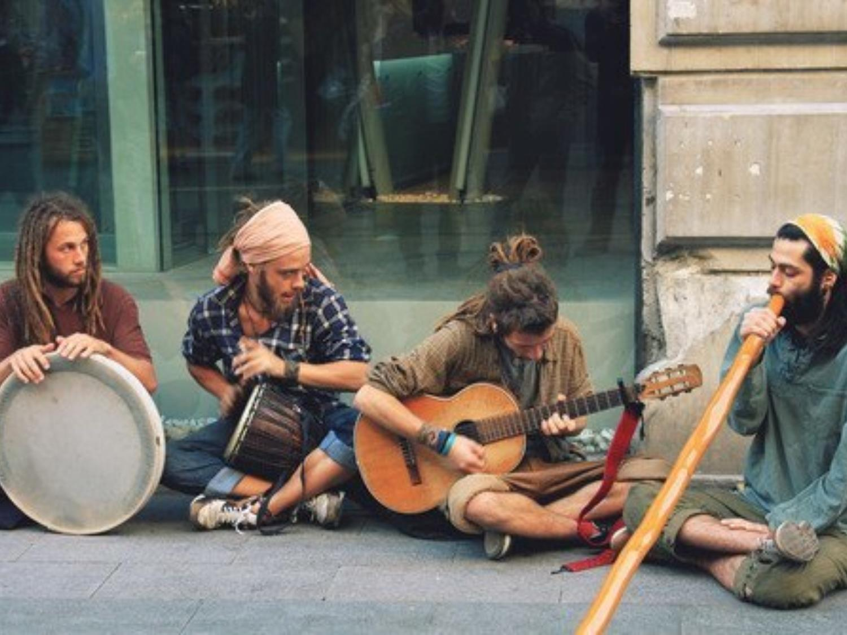
Music
„Live instead of surviving“, „Love instead tolerating“, „Walk instead of running“, Discover instead of learning“
Janis Joplin, Grace Slick, Bob Dylan, The Beatles, Rolling stones, The Who, Iron Butterfly, Frank Zappa, Jefferson Airplane, The Greatful Dead, Big Brother, Holding Company…

